Slide 1
Economic Systems

Slide 2
Bellwork
Who controls the American Economy?

Slide 3
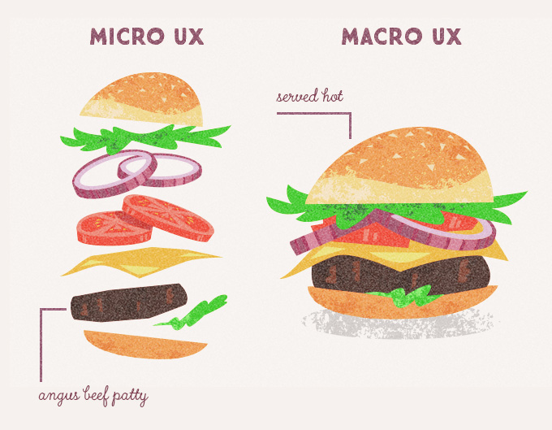
Micro v. Macro
Microeconomics is the study of decisions that people and businesses make regarding the allocation of resources and prices of goods and services
Macroeconomics is the study of the big picture of the economy; it examines conditions within the economy as a whole.

Slide 4
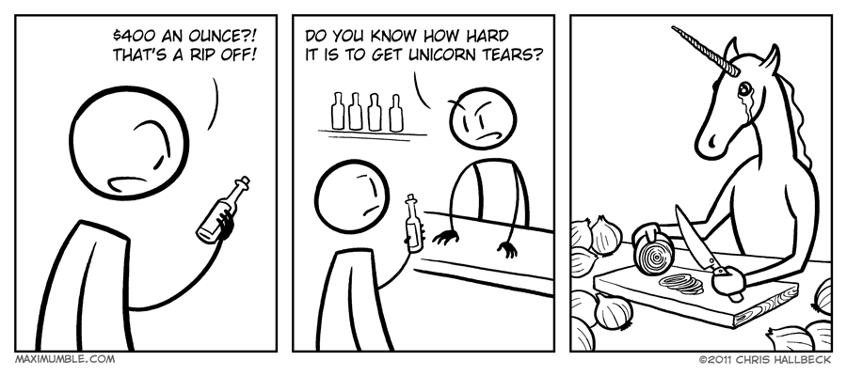
Economics
Economics is the study of how people make decisions in a world where wants are unlimited but resources are limited.
Economics helps us think about the process of making decisions
Scarcity is the combination of limited economic resources and society’s unlimited wants.
Scarcity is the most basic problem of economics because it forces people to make decisions about how to use society’s resources effectively.
An economic system is a set of rules that people consider when making decisions regarding distribution of scare resources.

Slide 5
Economic Systems
All around the world people need certain things to survive.
In addition to their needs, people also want items to make their life more comfortable.
Items that are not needed, but are desired are wants
People satisfy their needs and wants by obtaining goods and services.
How people obtain goods and services is what distinguishes different economic systems from one another.

Slide 6
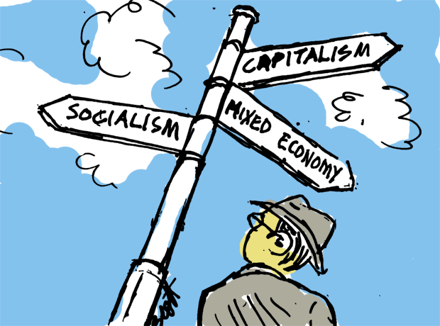
Economic Systems
Due to scarcity, we are forced to make decisions among alternatives. Doing so requires people to consider three fundamental economic questions.
WHAT is produced?
HOW is it produced?
WHO consumes what is produced?

Slide 7
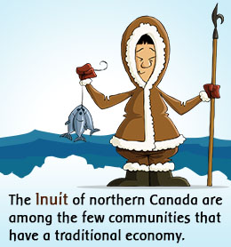
Traditional Economy
Economic decisions are based on how economic activity has been carried out in the past.
Economic activities are usually centered toward the family, tribe, or ethnic group.
Farming, hunting, gathering, and bartering are done largely in the same fashion as before.
Choices are determined by the environment and custom.

Slide 8
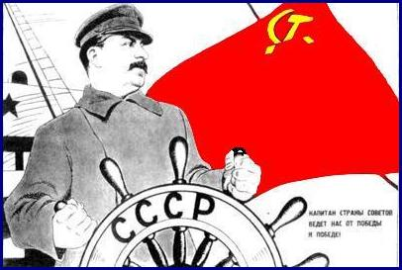
Command Economy
The government makes all economic decisions. The government also owns all factors of production.
Individuals have little, if any influence over economic functions.
Government decides what should be produced, the planning for production, and the distribution system.
No competition; purpose is to provide goods and services, not to make a profit.

Slide 9
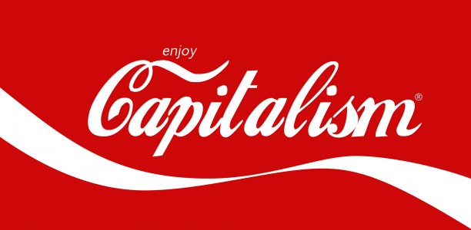
Market Economy
A market economy is an economy in which people are free to obtain goods and services in any way they want.
It is based upon freedom. People are free to own property, to create companies, and to buy products as they choose.
The right to buy and sell goods as you want is called a free market.
Resources are owned by individuals
In a free market, competition among sellers is the main factor in setting prices.

Slide 10
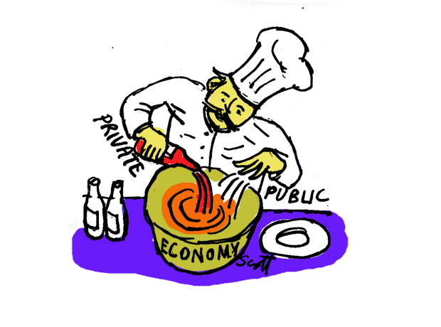
Mixed Economy
An economy that mixes elements of different economics systems; government and individual share the economic decision making process.
Business are largely free to operate as they please, but their operations must fall within certain regulations set up and monitored by the government.
Resources are owned by individuals

Slide 11
Economic Systems
The way economic system answer the key questions determine the roles of producers and consumers.
Economic systems influence people’s incentives, what motivates them to make decisions.
Cost/benefit
http://www.youtube.com/watch?v=yoVc_S_gd_0
The productive resources that are utilized are called factors of production.
The need for markets and resources promotes expansion but may lead to conflict.
Scarcity may lead to trade and economic interdependence or conflict.

Slide 12
Scarce Resources

Slide 13
Activity:
With your group come with advantages and disadvantages of each type of economic system.

Slide 14
Scarce Resources

Slide 15
Bellringer:
Place all of the economic systems discussed (except traditional) on a continuum from least economic freedom to most.

Slide 16
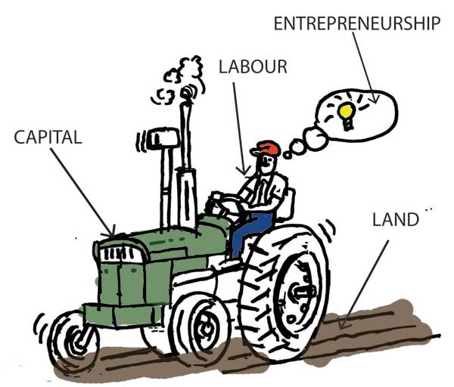
Factors of Production
Factors of production are the inputs utilized in the production of goods or serviced that are created for a profit.
There are 4 factors of production
Land
Labor
Capital
Entrepreneurship
http://www.youtube.com/watch?v=0PgP0dXAGAE

Slide 17
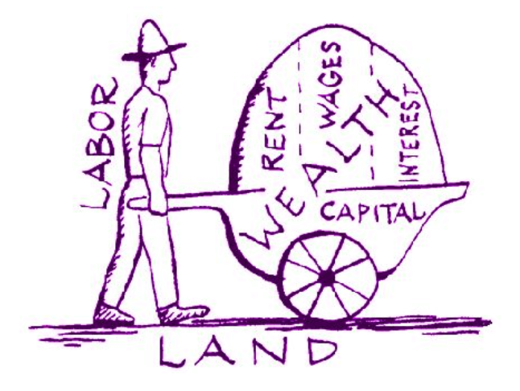
Factors of Production
Factors of production are the resources used in the production process. There are four main factors.
Land
Property/physical land where production is built
Natural resources – raw material produced in nature
Labor
All human effort, skill and abilities used to produce human goods and services
Skilled labor: required skill (doctor, lawyer, dentist)
Unskilled labor: no specific skill (janitor; cashier)

Slide 18
Factors of Production
Capital
The manufactured goods used to make other goods and services
Capital goods
NOT Financial capital
Entrepreneurship
An entrepreneur is a person who organizes, manages, and assumes the risks of a business.
Entrepreneurs often come up with an idea for a new product or a new way of doing business.

Slide 19
Market Economy
A market economy is an economy in which people are free to obtain goods and services in any way they want
Are there other terms for market economy?
Free enterprise
Capitalism
Price system
Laissez-faire

Slide 20
Market Economy
In a market economy, people are free to start a business and pursue a profit.
Profit is the money a business has left over after it has paid its expenses.
The profit motive, or the desire to make a profit, is essential to a successful market economy.
In order to make a profit, people need to provide a good or a service, which requires resources.
Since resources are limited, business must compete for the resources they need.
This affects prices we pay for the goods we want.

Slide 21
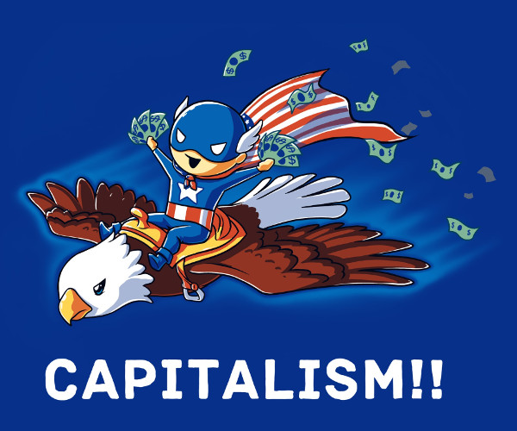
Market Economy
Capitalism is an economic system in which the means factors of production are owned by private citizens.
Private property is an essential part of a market economy
Private property is an essential part of a market economy, since market exchange cannot occur without clearly established ownership.
By encouraging investment, innovation, and the production of quality goods, the capitalist system benefits the American people.

Slide 22
Market Economy
Competition is vital to a market economy and is the main factor in setting prices. It also drives companies to improve their products.
Regulates prices and quality
While profit is the main motivator in a market economy, other factors might motivate producers too.
Price is the traffic signal of the economy.
Organizes the flow of resources and channels them to their most efficient use
Invisible Hand

Slide 24
Key Components of Market Economy
Profit = Motivator
Profit is the main motivation for producers in a market economy.
Competition = Regulator
Competition between producers regulates quality and price.
Producers need competitive prices for their goods to sell
Producers need to improve their products and develop products of quality that consumers want.
Price = Coordinator
Price coordinates the decisions consumers make based upon immediate concerns of self-interest

Slide 25
Key Characteristics
1. The right to own property
2. Freedom of enterprise
3. Freedom of economic choice
Work/not work
Spend/not spend
4. Role of self-interest
5. Competitive market system
6. Limited government

Slide 26
Bellringer
What are the key components of a market economy and the role of each?

Slide 27
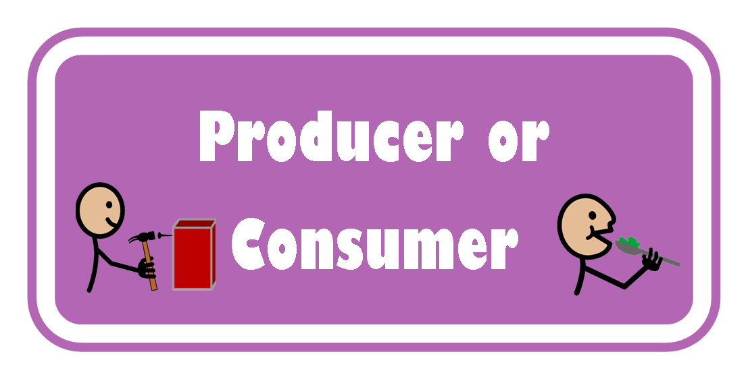
Circular Flow Model
What is the relationship between producers and consumers?
Producers – those who create and supply goods and services
Consumers – those who acquire goods and services
Producers are referred to as firms and consumers are referred to as households.

Slide 28
Circular Flow Model
Circular flow is an economic model that describes the reciprocal circulation of income between producers and consumers.
http://www.youtube.com/watch?v=_PKH2wtDT3E

Slide 29
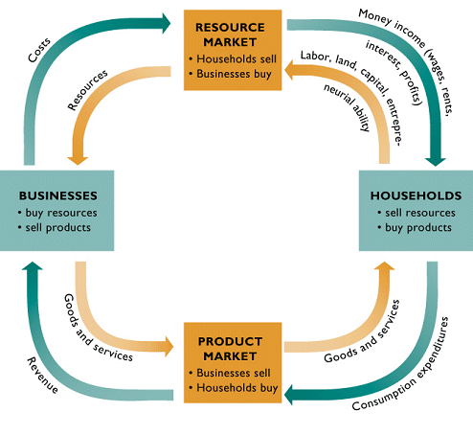

Slide 30
Market Structures
In a free market supply and demand determine price and quantity.
An industry consists of all firms making similar or identical products.
An industry’s market structure depends on the number of firms in the industry and how they compete.
Here are the four basic market structures:
Perfect Competition
Monopolistic competition
Oligopoly
Monopoly
http://www.youtube.com/watch?v=9Hxy-TuX9fs

Slide 31
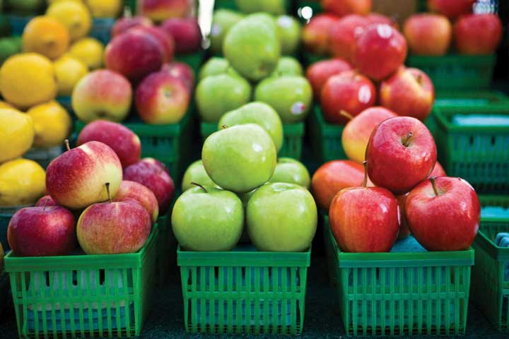
Perfect Competition
Many small firms
No control over price because too many firms
Goods are all the same; an identical, perfect substitute
Low barriers to enter the market
Examples
Fruit vendor
Wheat
Stock market

Slide 32
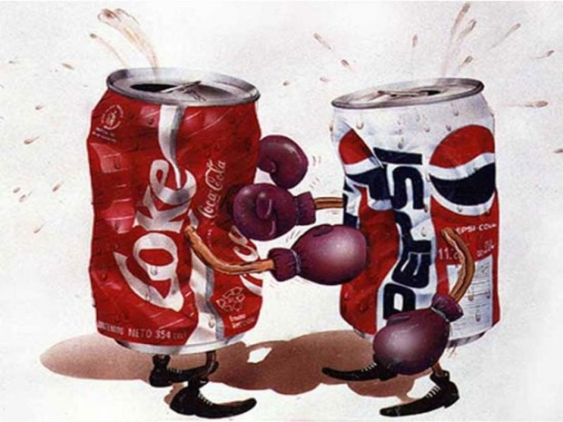
Monopolistic Competition
Many larger firms
Some control over price
Goods are slightly differentiated
Low barriers to enter market
Examples:
Shoes
Cereal
Fast-food

Slide 33
Oligopoly
Few firms
A lot of control over price
Goods can be identical or different
High barriers to enter market
Examples:
Airlines
Cell-phones
Hospital

Slide 34
Monopoly
One firm
Total control over price
Unique good
Highest barrier to enter market
In the US monopolies are banned except for certain public utilities.
Examples
Water service
US postal service

Slide 35
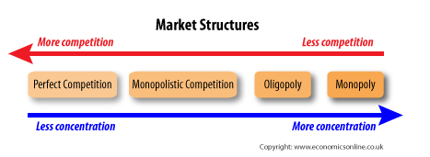

Slide 36
Bellwork:
Based on the profession you chose for your budget project, describe your role within the circular flow model. Provide specific examples how you might interact with the product and resource market.

Slide 37
Conglomerates and Mergers
Conglomerate large companies made of several businesses which are often unrelated
ex. General Electric owns NBC, financial services, and health care services
Mergers one company buys/joins another
Vertical Merger A merger between two companies producing different goods or services for one specific finished product.
company buys previous supplier (ex. Car company buys tire supplier)
Horizontal Merger company buys company making similar product (ex. BP bought Amoco)

Slide 39
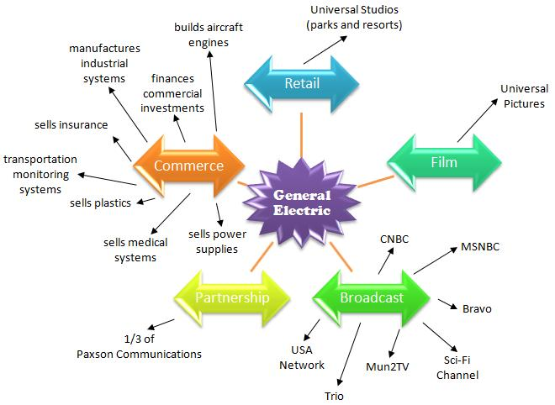

Slide 42
Bellringer
What are the different types of competition and how much control does each have over price?

Slide 43
Business Organizations
If you want to start a business, one of the first decisions you will have to make is how your business will be owned.
In the United States there are three main types of business organizations
Sole Proprietorship
Partnership
Corporation
http://www.youtube.com/watch?v=pPVkG9krOMI

Slide 44
Sole Proprietorship
A small business owned by one person is called a sole proprietorship.
There are many advantages of going into business for yourself.
Your own boss
Decide working hours and how business will operate
Takes all of the profit produced by business
There are also disadvantages.
Owner must have or borrow money for business
Must pay help
Personally liable for taxes
Unlimited liability

Slide 45
Partnership
A business in which two or more people share the responsibilities, costs, and profits is known as a partnership.
The advantages and disadvantages of a partnership are similar to that of a sole proprietorship.
More than one person to provide capital, share responsibility, furnish ideas, do work, and share risk.
Partners can loose personal belongings if fails.
It is important to have a written partnership agreement in place.
Partnerships can have general partners and limited partners.

Slide 46
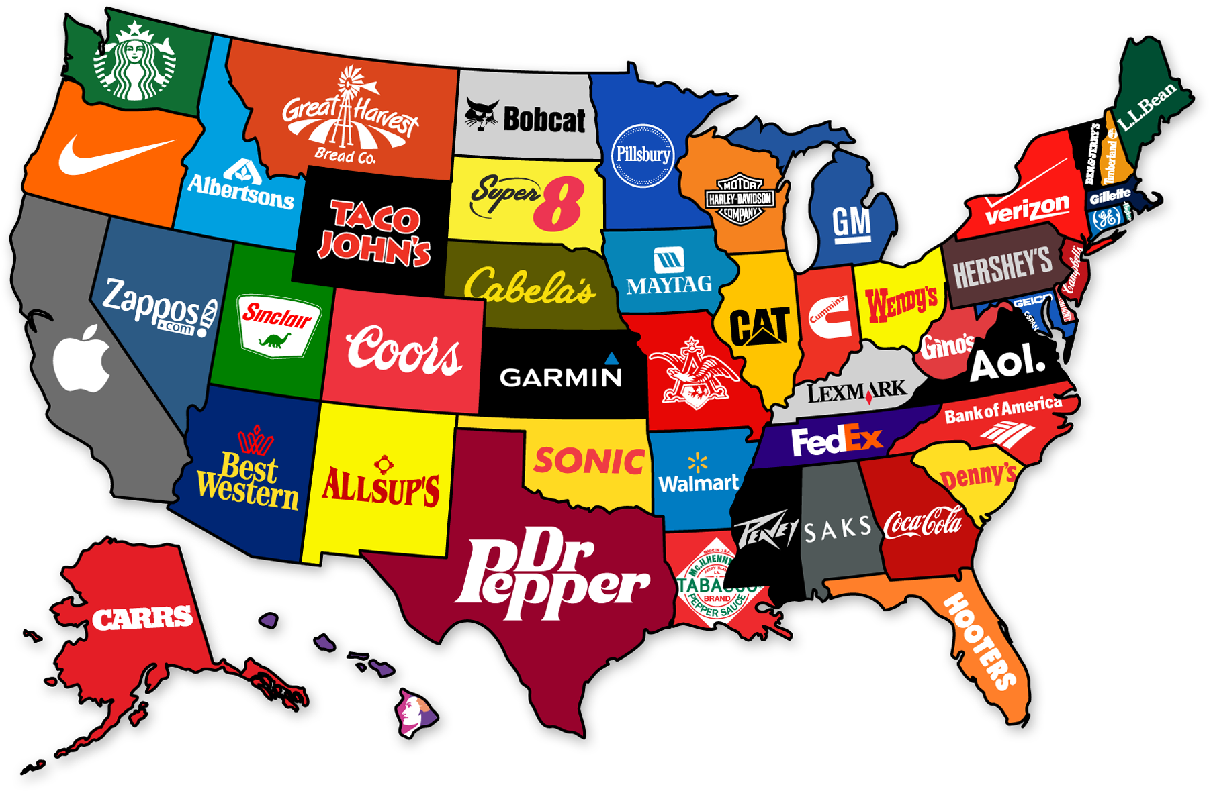
Corporations
A corporation is a type of business that is recognized as a separate legal entity.
A corporation is recognized as a separate, legal entity from the people who own it.
The corporation is a permanent organization, unlike proprietorships and partnerships which end when their owners die.

Slide 47
Corporations: Raising Money
Corporations raise money by selling stocks or shares of ownership. Each share of stock represents part of the corporation.
The people who buy corporate stocks are called stockholders.
Corporate profits paid to stockholders are called dividends. Each stockholder receives a portion of the profits based on the number of shares he or she owns.
Corporations can also raise money by selling bonds. People who buy bonds are lending money to the company. The company must pay interest on the bonds before its paying its stockholders.

Slide 49
Corporations: Rights to operate
State governments grant corporations the right to operate.
Each state has laws on how to incorporate a business.
File Articles of Incorporation with Secretary of State
Information includes: name of corporation; shares of stock; registered agent name and office; principal office address, and incorporators.
After incorporation, the company has the right to conduct business, sell stock, and receive protection of state laws.
In exchange for these benefits, corporation must obey state regulations. These include filing reports and paying taxes (DOUBLE TAXATION)

Slide 50
Corporations: Elected Directors
The stockholders elect the directors of the corporation.
Every corporation is required by law to hold at least one meeting of its stockholders each year.
At this annual meeting, stockholders elect a board of directors. They may also vote on changes in the corporation’s structure.
The BOD represents the stockholders and meets during the year to make decisions about the corporation.

Slide 51
Corporations: Choosing Executives
The BOD chooses corporate officers, or the people who manage the affairs of the corporation.
The officers include the company’s president and vice presidents, secretary, and treasurer.
Together, these officials oversee the daily operations of the corporation.

Slide 52
Corporations: Debt Responsibility
If the corporation’s business fails, neither the stockholders nor the corporation’s executives are responsible for the corporation’s debts.
If the corporation goes out of business, its assets are sold. The money raised is then used to pay off the corporation’s debts.
Business owners do not have personal liability for the business.

Slide 53
Non-Profit Organizations
Some business organizations provide goods and services without seeking to earn a profit.
These are called non-profit organizations
Include charities, research organizations, and organizations dedicated to cultural and educational programs.
Since these organizations do not make a profit, they are not taxed by the government.
Larger nonprofit organizations are often corporations. This is to raise capital and protect the assets.
Include American Red Cross, United Way, and the American Heart Association.

Slide 55
Labor Unions
Organizations of workers to bargain with employers.
Labor unions use collective bargaining
Collective bargaining is the basic process of negotiation between workers acting collectively either as a union or other type of worker organization and their employers on issues such as wages, work rules, child care, health and safety on the job, benefits, workplace conditions, etc.
Based on idea workers are stronger together
Often conflicts arise between business owners and unions
Mediation: neutral 3rd party to help labor and employers
Arbitration: 3rd party’s decision is legally binding
Strike workers refuse to work until demands are met

