Slide 1
Unit 9 part II

Slide 2
The Business Cycle

Slide 3
How do we measure our economy?
Gross Domestic Product
Gross domestic product is the total market value of all final goods and services produced within a country within a certain time
GDP does not measure goods and services not sold in the market
GDP only measures final goods
GDP does not measure well-being
GDP is expressed in terms of money. This enables us to compare the relative worth of goods and services, which is more meaningful than numbers of products.
Current (nominal GDP) is measured in inflation-distorted dollars. Real GDP converts the nation’s output into constant dollars.
When prices increase, GDP would go up even if the economy was not growing. By using real GDP economists can avoid this false impression.

Slide 5
Yet the gross national product does not allow for the health of our children, the quality of their education, or the joy of their play. It does not include the beauty of our poetry or the strength of our marriages; the intelligence of our public debate or the integrity of our public officials. It measures neither our wit nor our courage; neither our wisdom nor our learning; neither our compassion nor our devotion to our country; it measures everything, in short, except that which makes life worthwhile. And it tells us everything about America except why we are proud that we are Americans.”
- Robert F. Kennedy

Slide 6
National Economic Activity
Gross Domestic Product is the market value of the all goods and services produced annually in the United States.
$16.720 trillion; 1st in the world
Exports: $1.575 Trillion
Imports: $2.273 Trillion
US exports:
agricultural products (soybeans, fruit, corn) 9.2%,
industrial supplies (organic chemicals) 26.8%
capital goods (transistors, aircraft, motor vehicle parts, computers, telecommunications equipment) 49.0%
consumer goods (automobiles, medicines) 15.0%

Slide 7
Bellwork
What are some signs that may indicate how the economy is doing?

Slide 8
How do we measure our economy?
Unemployment Rate – the percentage of people in the labor force who are not working but are looking for jobs.
People who are jobless, looking for jobs, and available for work are unemployed.
Unemployment does NOT include those under 16, institutionalized, or not looking for employment.
There are 4 types of unemployment
Frictional – people who are in between jobs
Structural – caused by a mismatch between jobs seekers and job openings
Seasonal – temporary unemployment due to conditions that prevail during certain seasons of the year
Cyclical – unemployment due to lack of overall demand in the economy

Slide 9
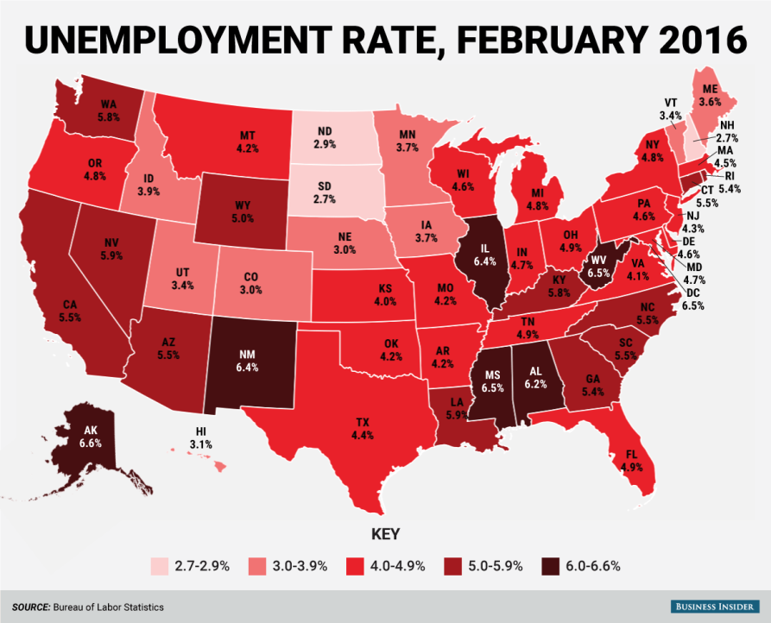

Slide 10
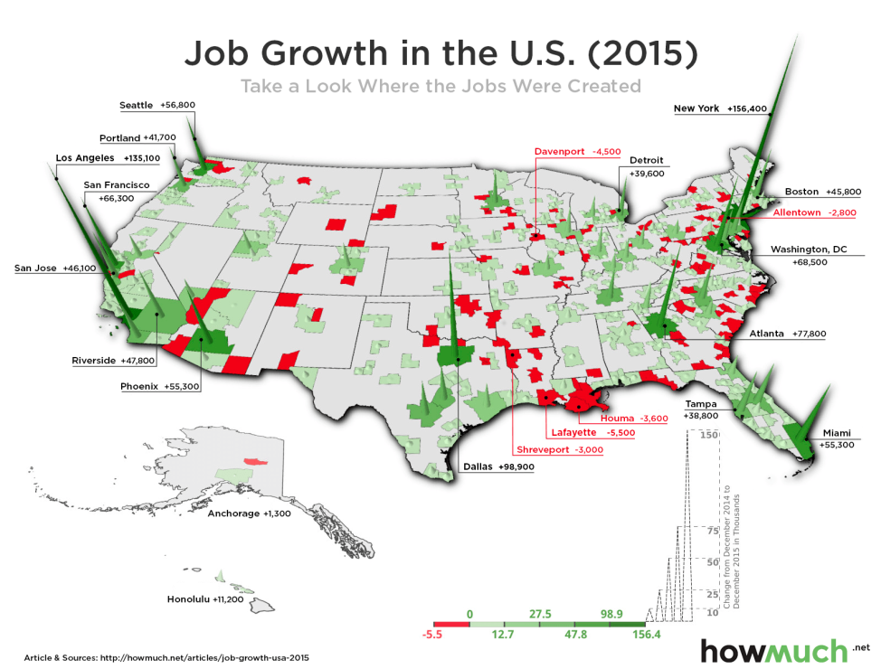

Slide 11
Economic Indicators
Traditional
Non-Traditional
Gross Domestic Product
Unemployment Rate
Inflation Rate
Adult literacy rate
Children living in poverty
Number of homeless
Amount of leisure time

Slide 12
How do we measure our economy?
Inflation is an increase in the general price level.
Inflation can be measured by the Consumer Price Index.
CPI is a measure of the average change over time in the prices paid by consumers for a market basket of consumer goods and services
To track inflation the government samples prices every month for products commonly used by consumers. The rate of inflation is the change in the average level of prices. The CPI can be used to measure the rate of inflation
Ponder…
How does inflation affect business decision making?
Why might the increase in the price of oil lead to inflation?
http://www.youtube.com/watch?v=Vg4-gMW89E0
CPI is used by the president, Congress, and Federal Reserve Board in determining fiscal and monetary policy.

Slide 14
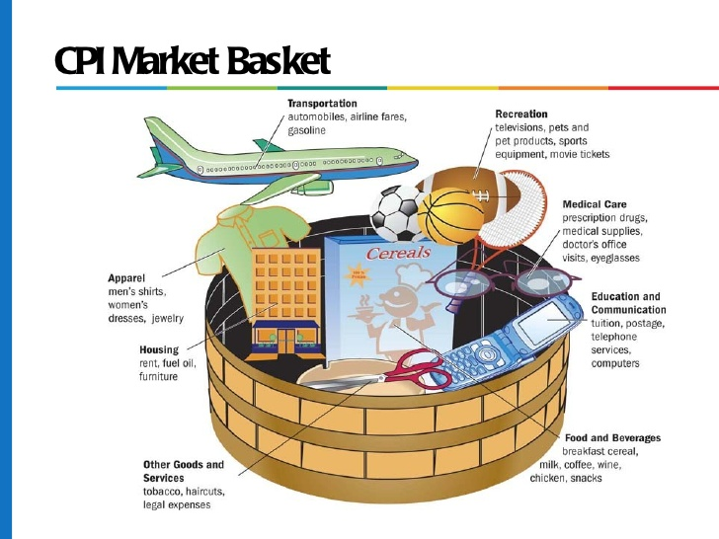

Slide 17
Yes or No
In order to make money, Tyler decides to sell cocaine outside rock concerts. Is the value of his goods and services included in GDP?
Martha hires the service Merry Maids to clean her home each week. Is the value of the cleaning service included in GDP?
Michael is 15 years old and unable to find an afterschool job. Is included in unemployment?
Susan lost her job and is not currently looking for a job. Is Susan included in the unemployment rate?

Slide 18
The Business Cycle
The business cycle is the economic pattern in which an economy goes through good times and bad times.
It is the short-term fluctuations of economic activity along its long term growth.
The business cycle is a common feature in free-market economies.
4 main parts
Expansion
Peak
Contraction
Trough
http://www.youtube.com/watch?v=jGP-vPEHRRE

Slide 20
Business Cycle
Expansion is when the economy is growing larger; a period of growth
Unemployment rate falls (employment increases)
Real GDP (production) increases
One problem that often accompanies a boom is inflation.
At some point the expansion of the economy stops. When this happens, the business cycle has reached its peak.
Highest point of expansion; economists can only measure once contraction begins

Slide 21
Business Cycle
After the economy peaks, business activity begins to slow. This economic slowdown is called a contraction.
Unemployment increases (decreased employment)
Real GDP decreases for 6 consecutive months
A recession occurs when there is a least two consecutive quarters of decline in real GDP.
A depression is an extreme recession that lasts two or more years
Characterized by increased unemployment, drop in available credit, reduced output, bankruptcies, decline in investment
When the economy reaches its lowest point, it is said to be a in a trough.
Lowest point; economists can only measure once expansion begins

Slide 22
Bellwork
What can cause contraction in the business cycle?
How do people and businesses react to contraction?

Slide 23
Coping with Economic Changes

Slide 24
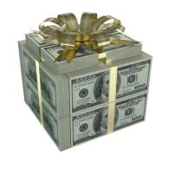
Causes of economic problems
Different factors affect the economy’s condition.
During times of economic growth, the economy often experiences inflation.
Why is inflation a problem?
An economy that is not growing supports fewer jobs and leads to higher unemployment. Unemployed workers are unable to pay bills and taxes. They also buy fewer goods and services.
What contributes to these economic difficulties?
Money supply
Government spending

Slide 25
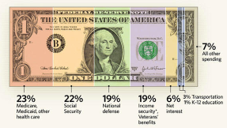
Causes of Economic Problems
The Money Supply
One cause of inflation is having too much money in circulation. As people spend the additional money, prices increase.
Inflation can also be caused when a lending institution makes too many loans. Those that borrowed the money spend it on goods and services.
Government Spending
The government spends a lot of money each year.
Much of the money spent by the government comes from taxes paid. The government also borrows money.

Slide 26
Response to Economic Problems
The government can change fiscal policy, its policy of taxing and spending to aid the economy.
The government may decrease or increase taxes
The government may decrease or increase its spending
The economy may also be aided by changes in monetary policy or a change in the money supply.
The Federal Reserve System is the country’s central bank and works to control the amount of money in the economy.
The Fed may buy or sell government bonds
The Fed may raise or lower the reserve requirement
The Fed may raise or lower the discount rate

Slide 27
Money and Banking
What is money?
Types of financial institutions
How banks operate
The Federal Reserve System

Slide 28
What is Money?
Money – Anything people are willing to accept in exchange for goods and services
Coins, Currency
Money has value because we KNOW someone else will accept its value.
Paper money is fiat money
Fiat money is currency that a government has declared to be legal tender, but is not backed by a physical commodity
It is not “backed” by gold
Has value only because of government regulation or law

Slide 29
Types of Financial Institutions
Commercial Banks – offer full range of banking services
Savings and Loan Associations – loaned money to people to buy homes
Credit Unions – members of the group that sponsors them (unions, businesses, government institutions) and offer low costs

Slide 30
What do banks do?
Make money by charging interest on loans they make to individuals and businesses.
Pay interest to people who save their money.
Interest on money loaned is higher than money interest paid to savings accounts.
FDIC (Federal Deposit Insurance Corporation) insures individual accounts up to $250000
How do banks get their money to lend to people?
Investments, savings accounts, and loans from the Federal Reserve.

Slide 31
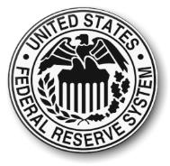
The Federal Reserve System
At one time, banks were allowed to conduct business with few rules. As a result, they sometimes lent money to high-risk customers and did not get enough collateral in return for loans.
To prevent bank failures and to give people more confidence in the safety of banks, the federal government created a plan to regulate the US banking system.
In 1913 Congress set up the Federal Reserve System.
The Fed regulates banks by requiring that they keep a certain amount of money in reserve.

Slide 32
The Federal Reserve System
The Federal Reserve System divide the United States into 12 federal districts. A reserve bank is located in each district.
The Federal Reserve is the central bank of the United States.
When banks in the U.S. need money, they borrow money from the FED.
The Federal Reserve System is managed from DC by a seven member board of governors.
Each member is appointed by the president and confirmed by the Senate.

Slide 33
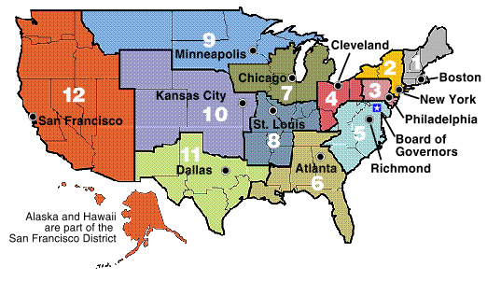

Slide 34
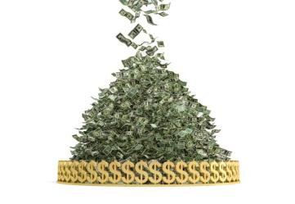
Federal Reserve System
Major policy making group in the Fed is the Federal Open Market Committee (FOMC)
FOMC manipulates the money supply.
The FED can increase or decrease the supply (or the amount) of money in the economy.
Why is it necessary to control the money supply?

Slide 35
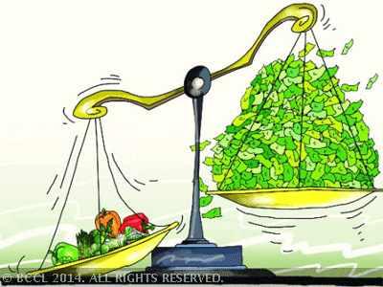
Money Supply
Inflation – sustained increase in the general level of prices. Why does it hurt the economy?
Reduces purchasing power (too much money chasing too few goods) and alters decisions people may make.
Consumer Price Index (CPI) – sample prices of 400 products commonly used by consumers. If it goes up, inflation (or prices) are rising in the economy.

Slide 36
Bellwork
Is the FED good or bad for the economy? Why or why not?

Slide 37
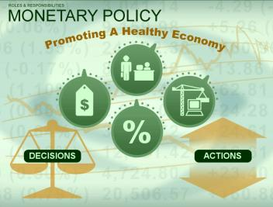
Monetary Policy
The Fed uses several tools to manipulate the money supply.
Discount rate
Reserve requirement
Open market operations
Discount rate is rate the Fed charges member banks for loans.
Stimulate economy = lower rate
Slow down economy = higher rate

Slide 38
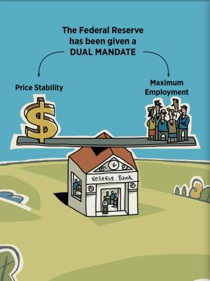
Monetary Policy
When prices go up, people and businesses begin to speculate (land, art, or other items) that go up in value.
People speculate instead of investing in capital goods and services.
What can be done to remedy inflation?

Slide 39
Monetary Policy
If inflation is high, reduce the supply of money. TIGHT MONETARY POLICY
Three ways:
Raise the reserve requirement. The Fed requires banks to keep a certain percentage of their money in Federal Reserve Banks (as a reserve against their deposits.)
a. Suppose a banks has $100,000 in deposits and the reserve requirement is 2 percent. How much of that $100,000 is NOT in the economy (being lent to business and individuals)?
b. What if the FED raises the reserve requirement to 5 percent? What happens to the supply of money?

Slide 41
Fiscal Policy
Fiscal policy is the government using taxing and spending to aid the economy.
Fiscal policy is used by ALL levels of government.
Expansionary Policies: Policies that try stimulate the economy
Contractionary Policies: Policies that try to slow down the economy
http://www.youtube.com/watch?v=1qhJPqyJRo8&list=PLF2A3693D8481F442&index=26

Slide 42
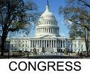
Who makes Fiscal Policy?
Congress and the President make fiscal policy through the federal budget.
The Federal Reserve (another government agency) DOES NOT make fiscal policy.

Slide 43
Fiscal Policy
During a contraction or recession, the government can do two things (expansionary policies):
Increase spending
Decrease taxes
The goal is to have more money for people to spend
More money = more demand
More demand = more production
More production = more jobs
More jobs = more demand etc. etc.

Slide 44
Fiscal Policy
During a period of excessive inflation (during a period of expansion), the government can do two things:
Increase taxes
Decrease spending
The goal is to have less money = less demand = lower inflation (contractionary policies)

Slide 45
Who favors which policy
Decreasing Taxes
Favored by Republicans
Let people decide what to spend their money on and let those who earned the money benefit from it.
Increase Spending
Favored by Democrats
Government should spend to redistribute wealth to the poor, rather than give the rich a tax cut

Slide 47
Bellwork
Why do people with different incomes pay different percentages in taxes?

Slide 48
What are taxes?
Taxes are payments people are required to pay to local, state and national government. Taxes are used to pay for services provided by the government.
Article 1, Section 8, Clause 1 of the Constitution grants Congress the power to tax.
“The Congress shall have Power To lay and collect Taxes, Duties, Imposts and Excises, to pay the Debts and provide for the common Defense and general Welfare of the United States; but all Duties, Imposts and Excises shall be uniform throughout the United States”
The Sixteenth Amendment gives Congress the power to levy an income tax.
“The Congress shall have power to lay and collect taxes on incomes, from whatever source derived…”

Slide 49
Types of Taxes
Progressive
Progressive taxes are taxes where the rate increases as the amount subject to tax increases.
People with more money
Ex: income tax with tax brackets
Regressive
Tax which takes a higher percentage of income from the poor than from the rich
Ex: sales tax
Proportional
Rate is fixed and does not change as the taxable amount increases or decreases

Slide 50
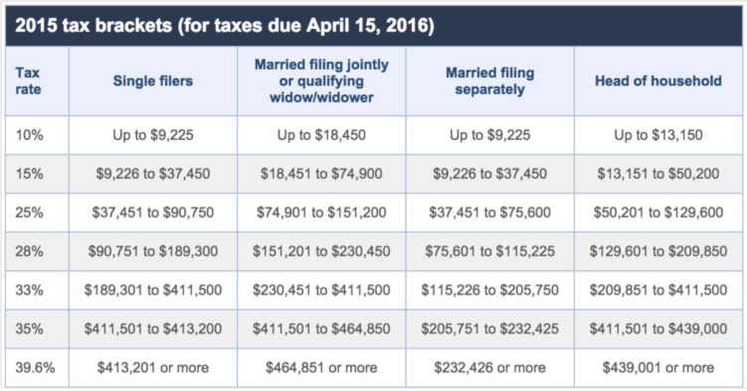

Slide 51
Monetary Policy
The Fed can also change the money supply through open market operations. These are purchases or sale of US government bonds.
Buying bonds puts more money in investor’s hands and increases the money supply. This causes consumers to borrow money and increase demand.
If the Fed can sell bonds to take money out of the system by having people exchange money for a piece of paper (promise to pay at a later date) called a treasury bond.

Slide 52
Organizations
Different organizations play a role in the US economy.
These organizations include:
Federal reserve
Controls the money supply
Nonprofit organizations
Are a valuable part of the economy because the serve the public and provide a benefit other than the accumulation of profit
Wall Street
Banks
Labor unions

Slide 53
Organizations
Financial institutions facilitate allocation of financial resources from its source to potential users.
The financial system connects savers to borrowers.
Wall Street is the financial district of NY.
Entrepreneurs gets money for new businesses by borrowing money through banks.
When people become afraid that too many loans will not be repaid, a run on the bank may occur
FDIC

Slide 54
The Rise of Labor Unions
As American industry expanded, growing numbers of workers became dissatisfied with their labor conditions.
Men and women began to organize into groups to demand better conditions from their employer.
These organizations of workers became known as labor unions.
Typical labor union demands included better wages, safer working conditions, and shorter workdays.
To achieve these goals, union leaders needed the right to bargain with employers. This form of negotiation between labor and management is called collective bargaining.
Representatives from a labor union meet with representatives of an employer. Each side argues for the changes it wants or does not want and some sort of compromise is reached.
The terms of the agreement are put into a contract.

Slide 55
Methods Used by Labor
When employers refused to deal with unions, labor leaders often respond with a strike. In a strike, union members walk off the job if employers do not agree to labor’s demands.
If a company tries to hire other workers during a strike, the strikers try to prevent this by picketing.
Sometimes workers will stay on the job, but work much more slowly than usual. This union action is called a slowdown.
Any kind of slowdown or action short of a strike is called a job action.

Slide 56
Methods used by Employers
Employers sometimes locked workers out so they could not work. They would also send lists of names of workers active in the union and asked places to not hire those workers.
Business owners sometimes hired armed guards to protect their property from striking workers.
In major strikes, employers asked government officials for help.
http://www.amosweb.com/cgi-bin/awb_nav.pl?s=wpd&c=dsp&k=gross+domestic+product,+ins+and+outs

Slide 57
Labor Today
Today many American enjoy much better working conditions than they did in the past. Still there are disputes that arise between unions and employers.
Sometimes to resolve a dispute an expert may be asked to examine the issue and recommend a solution. This method is called mediation. The recommendation is not legally binding.
Sometimes arbitration is used instead. In this method the decision of the expert arbitrator is binding on both sides.

