Slide 1
Economic Interdependence and Trade

Slide 2
Bellwork
Why do we trade?

Slide 3
International Trade
International trade is one of the major forces in the world today.
Exports: good sold to other countries
Imports: goods purchased from other countries
The basic problem in economics is scarcity. Trade is one way nations can solve the problem of scarcity.
Voluntary trade must be beneficial for both parties.
Nations trade for some goods and services because they could not have them otherwise.

Slide 4
Comparative Advantage
Countries trade with one another because of a comparative advantage.
The ability of a country to produce a good at a lower opportunity cost than another country can.
Opportunity cost: the cost of the next best alternative use of time or money when choosing to do one thing over another
Comparative advantage allows nations to specialize in production of products it can produce at a lower opportunity cost.

Slide 5
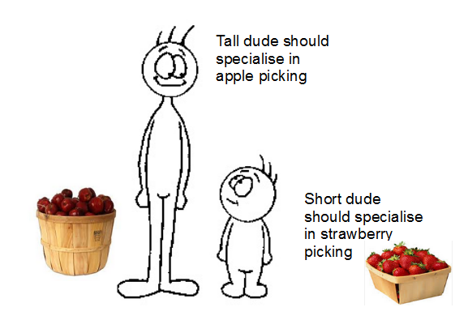

Slide 6
Comparative Advantage
Countries possess certain advantages.
Climate, geography, the skills and size of their labor force— all contribute to make a country good at producing certain things.
Countries have to make certain sacrifices in deciding which of the goods that they can produce should they produce
To produce corn instead of wheat, cars instead of boats, computer chips instead of refrigerators.
Being rational operators, they eventually produce those products in which they have a comparative advantage, those goods having a comparatively low opportunity cost.

Slide 7
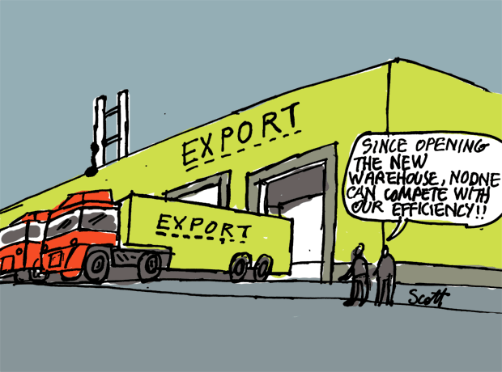
Absolute Advantage
Absolute advantage refers to a country’s ability to produce a good more efficiently than another country.
Absolute advantage only considers productivity and doesn't take any measure of cost into account.
Therefore, one can't conclude that having an absolute advantage in production automatically means that a country can produce a good at lower cost

Slide 8
Example: Trying to decide whether to become a fry cook or a heart surgeon.
You’re are a wonderful fry cook and a talented heart surgeon. Your neighbor is a pretty good fry cook and (since he is near-sighted and has a severe hand tremor) an absolute butcher as a surgeon.
You have an absolute advantage over your neighbor as a fry cook. He just can’t hang with you around a pan of sizzling lard. And you also possess an absolute advantage over him as a surgeon—your patients actually survive their surgeries occasionally.
Which career should you pursue?
To become a fry cook, you must sacrifice your far more lucrative work as a heart surgeon; your opportunity cost is very high.
On the other hand, your moderately skilled fry-cooking neighbor has a relatively low opportunity cost—to pursue a career as a fry cook he only has to sacrifice his malpractice-suit-waiting-to-happen career as a surgeon.
Therefore your neighbor has a comparative advantage in fry cooking... even though you're objectively a better fry cook than he is.

Slide 14
Comparative Advantage
Comparative advantage lets nations specialize.
Specialization: when a worker or machine performs one or just a few tasks of production
Many countries specialize because they do not produce everything needed.
A country that does not have a comparative advantage may be driven out of the market. This is because a nation that does have a comparative advantage may

Slide 15
Closure
3: Main points from today’s lesson
2: Reasons for specialization
1: Question you still have

Slide 16
Bellwork
Assume that Jay and Leah can spend the day either washing cars or mowing lawns. The table below shows how much of each task they could accomplish in one day if they spent the whole day doing just that task.
Jay Leah
Cars washed 20 15
Lawns mowed 5 3
Who has the absolute advantage in washing cars? Mowing lawns?
Who has the comparative advantage in washing cars? Mowing lawns?

Slide 17
Financing Trade
Different nations have different currencies.
United States = the dollar
Mexico = peso
Japan = yen
If you travel outside the US or invest in foreign business, you will want to know the exchange rate what the price of your nation’s currency is in terms of another nation’s currency.
Most of the nation’s use a flexible exchange rate system. Under this system the forces of supply and demand are allowed to set the price of various currencies.

Slide 18
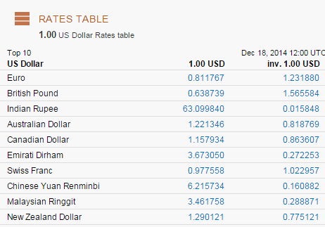

Slide 19
The Balance of Trade
A currency’s exchange rate can have an important effect on a nation’s balance of trade.
The balance of trade is the difference between the value of a nation’s exports and its imports.
If a nation’s currency depreciates or becomes weak, the nation will likely export more goods because its products will become cheaper for other nations to buy.
If a nation’s currency appreciates in value the amount of its exports will decline.

Slide 20
Trade Deficit and Surplus
A country has a trade deficit whenever the value of the products it imports exceeds the value of the products its exports.
It has a trade surplus whenever the value of its exports exceeds the value of its imports.
Specialization can result in overproduction. Meaning the country produces more of a good than all the people in the country could consume.
What should that country do with the overproduction?

Slide 22
Interdependence
Global interdependence means that people and nations all over the world now depend upon one another for many goods and services.
The most important aspect of economic interdependence is trade.
Trade includes both competition and cooperation.
Nations compete to sell their their products.
They also cooperate to make trade beneficial for everyone

Slide 23
Globalization
Globalization is the global exchange of goods, services, capital, ideas, information, and people.
The advantages and disadvantages of globalization have been heavily scrutinized and debated in recent years.

Slide 24
Questions about globalization?
1. What is globalization?
2. How new is globalization?
3. What has led to increased globalization?
4. What are some positive effects of globalization?
5. When people trade, how do both sides benefit?
6. What are some negative effects of globalization?
7. What are some effects of multinational businesses?
8. What are some of the issues involved with outsourcing jobs?
9. What is the future of globalization?

Slide 26
Globalization
Globalization has become an important factor in many countries economies.
Two main factors have caused the drastic increase in globalization:
Technological ease of exchange
Shift in government policies
Proponents of globalization say that it helps developing nations "catch up" to industrialized nations much faster through increased employment and technological advances.
Critics of globalization say that it weakens national sovereignty and allows rich nations to ship domestic jobs overseas where labor is much cheaper.

Slide 27
Bellwork
How do nations become interdependent? What are some of pros and cons of this interdependence?

Slide 28
Global Interdependence
Global trade has many advantages
Businesses can make more profit
Competition may result in lower prices for consumers and a greater range of products
Global trade can also lead to problems
Competition may force weak companies out of business, hurting some national economies and costing workers their jobs.
Many nations support a policy of free trade that aims to eliminate tariffs and economic barriers.
North American Free Trade Association
World Trade Organization

Slide 29
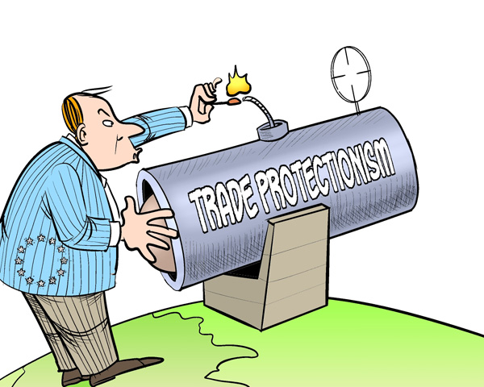
Barriers to International Trade
There has been a change in government polices allowing more globalization. However, nations do still try to protect their industries from foreign competition.
In a country that does not have a comparative advantage consumers are likely to buy foreign produced goods because they are cheaper.
When they do so the companies in the consumer’s own country that employ these workers lose sales.
Those companies are likely to cut back on production and lay off workers.
The people frequently urge the government to step in to remedy the situation.
Protectionism – government policies that restrict international trade with the intent of protecting local businesses

Slide 30
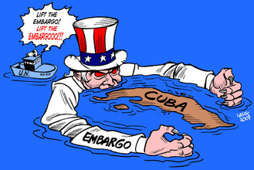
Barriers to international trade
There are different types of barriers to trade that exist.
With your group define each of these types of barriers and provide an example of each.
Sanction
Subsidies
embargo
Tariff
Quotas

Slide 31
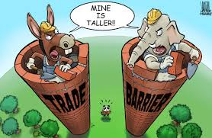
Barriers to international trade
Sanction
Trade sanctions are trade penalties imposed by another country
Sanctions can take the form of embargos, tariffs, duties, etc.
Subsidies
Subsidies are monetary support from the government for producers of a product that enable the producer to sell good cheaper than a foreign competitor
Embargo
An embargo is a complete prohibition on imports or exports to or from another country.

Slide 32
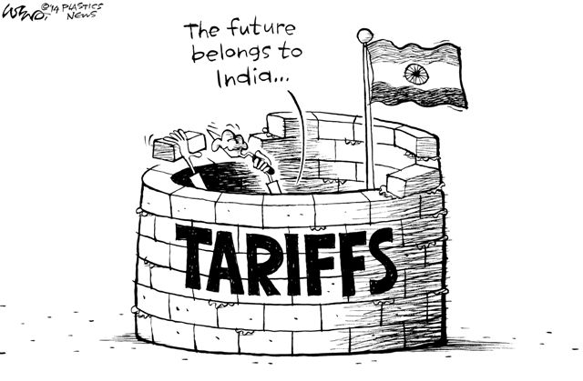
Barriers to International Trade
Tariffs
A tariff is a tax on an imported good.
The goal of tariffs is to make the price of imported goods higher than the price of the same good that is produced domestically.
As a result, consumers would be more likely to buy the domestic product.
Quotas
Quotas are limits on the amount of foreign goods imported.
No more than the amount of the good set by the quota can be brought into the country.
Putting quota on a good usually establishes a shortage.

Slide 33
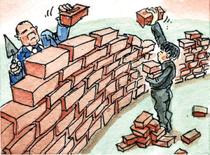
Protectionism
Protectionism is defended by three main ideas
Save jobs in domestic industries
Fear of dependence upon foreign goods
Protectionist policies need to be reflective of those in other countries
Opponents of protectionism say that barriers are not always effective and that policies end up hurting the people it was designed to protect and often promote free trade as a superior alternative to protectionism.

Slide 34
Trade Agreements
Most countries try to reduce trade barriers.
They aim to achieve free trade – convincing countries not to pass laws that block or limit trade.
An important trend is for countries to join together and set up zones of tree trade with a few key trading partners.

Slide 35
European Union
28 European countries
There are not trade barriers among these nations
Most of the countries also use a common currency

Slide 36
NAFTA
In the 1990s, the US, Canada, and Mexico signed a pact called the North American Free Trade Agreement.
This deal eliminates barriers to trade among the the three countries.
Opponents: American workers lose jobs
Proponents: increased trade would stimulate growth and put more low-cost goods on the market.

Slide 37
WTO
An international body called the World Trade Organization oversees trade among nations.
It organizes negotiations about trade rules and provides help to countries trying to develop their economies.
Opponents: WTO policies favor major corporations at the expense of workers, the environment, and poor countries.

Slide 38
Bellwork
How has globalization effected culture?

Slide 39
Fact Scenario
Imagine your family lives in Manteo, NC and that you have been in the shrimping business for generations. For the last several decades, your family has done very well financially thanks to the abundance of shrimp off the NC coast, an increase in demand for shrimp nationwide, and little competition. Recently, however, the US and NC dramatically increased the amount of shrimp imported from other countries. The imported shrimp, though not as high quality as your family’s, is far cheaper and more abundant than NC shrimp. Your family is beginning to feel the effects of competition and you are worried that soon you will no longer make enough in the shrimping business to pay bills.

Slide 40
Questions
Who wins in this situation?
Who loses in this situation?
What should your family do?
What would you do if you were a typical shrimp consumer?
Is there anything that can be done to assist your family and other NC shrimpers?
http://www.youtube.com/watch?v=-qwqkaEjBtE

Slide 41
Closure
How does globalization affect you?
What clothes are you wearing from another country?
Where were family cars and appliances made?
What role does North Carolina have in globalization?

Slide 42
North Carolina
North Carolina’s role in the US Economy
North Carolina has become a nation leader in agriculture, manufacturing, and financial-services.
North Carolina has experienced growth in film production and tourism
North Carolina’s role in the Global economy
Tobacco farming
Hog farming
Furniture
Textiles and apparel
Biotechnology
Financial institutions
Tourism
Fishing
http://www.youtube.com/watch?v=ouiGr1cQR7c

Slide 43
North Carolina
The prosperity and stability of a nation’s economy is dependent upon a stable global economy
How do you think North Carolina should deal with the job loss?

