Slide 1
The Vietnam War: The War Develops

Slide 2
Main Idea
Concern about the spread of communism led the United States to become increasingly violent in Vietnam

Slide 3
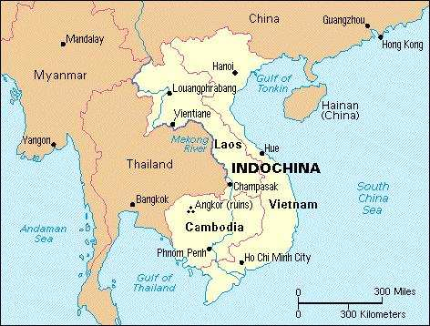
Southeast Asia’s Colonial History
1883 - France gained control of Vietnam
Combined Vietnam with Laos and Cambodia to form French Indochina

Slide 4
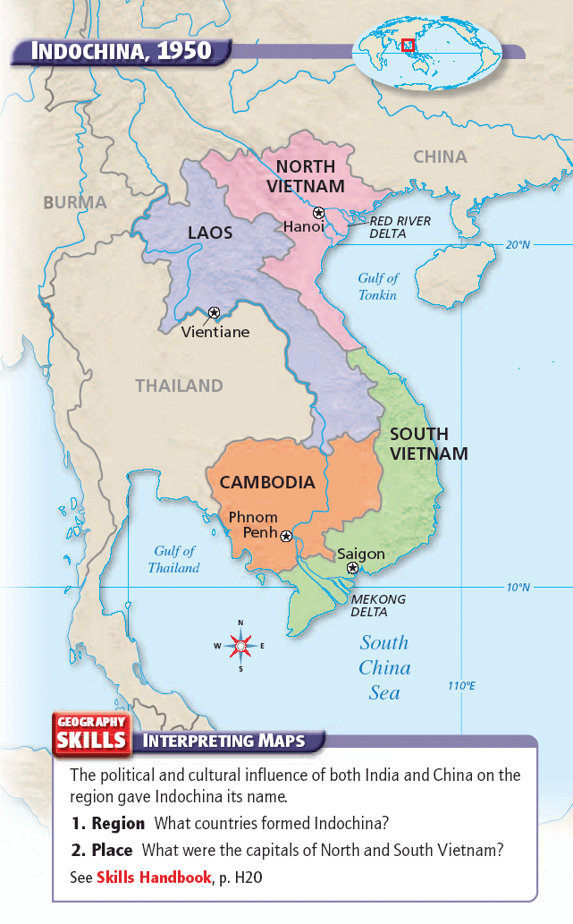

Slide 5
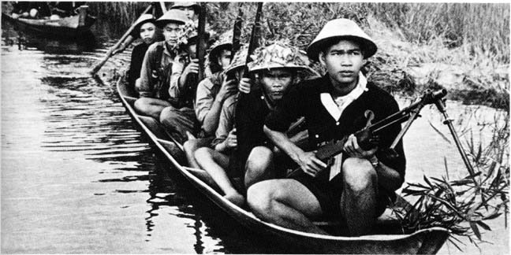
Colonial Vietnam
During WWII Japan occupied French Indochina
The Vietminh were organized to fight the Japanese
After WWII the Vietminh declared Vietnam to be independent
The French reclaimed Vietnam

Slide 6
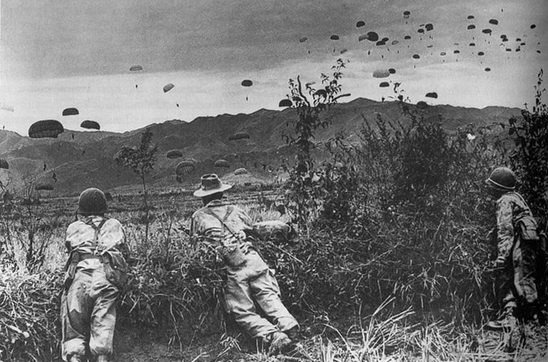
U.S. policies in Vietnam After WWII
U.S. supported France
Unwilling to back the Vietminh because many were Communists

Slide 7
U.S. policies in Vietnam After WWII
Events:
Communists seized China in 1949
Communist North Korea invaded South Korea in 1950
Communist-led revolts in Indonesia, Malaya, and the Philippines

Slide 8
Vietnam After WWII
Domino theory
Belief that communism would spread to neighboring countries if Vietnam fell to communism
U.S. supported the French during the Vietnam War
U.S. paid more than 75% of the cost of the war

Slide 9
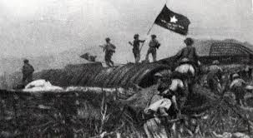
Vietnam After WWII
French soldiers made a last stand at Dien Bien Phu
French forces hoped for a U.S. rescue
Did not want to send U.S. soldiers to Asia so soon after Korea

Slide 10
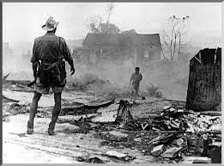
Vietnam After WWII
1954 - After eight years of fighting the French surrendered
The Vietminh had learned how to fight a guerilla war against an enemy with superior weapons and technology

Slide 11
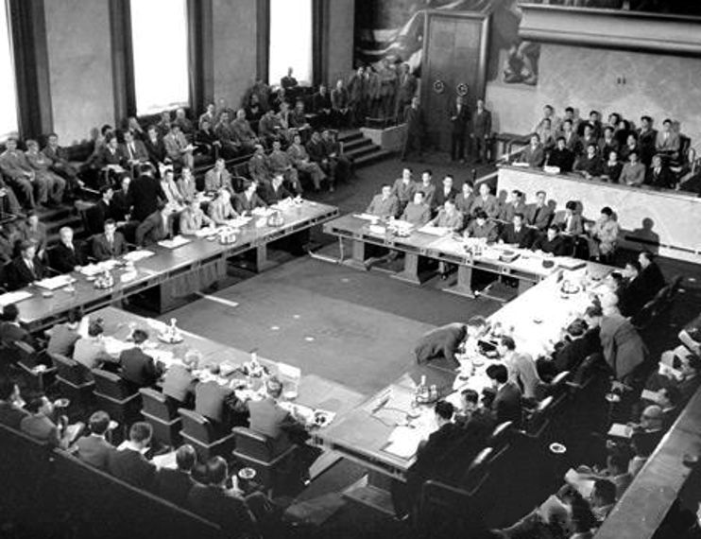
The Geneva Conference
The Geneva Conference
Goal was to work out a peace agreement and arrange for Indochina’s future
Vietnam was “temporarily” divided at the 17th parallel

Slide 12
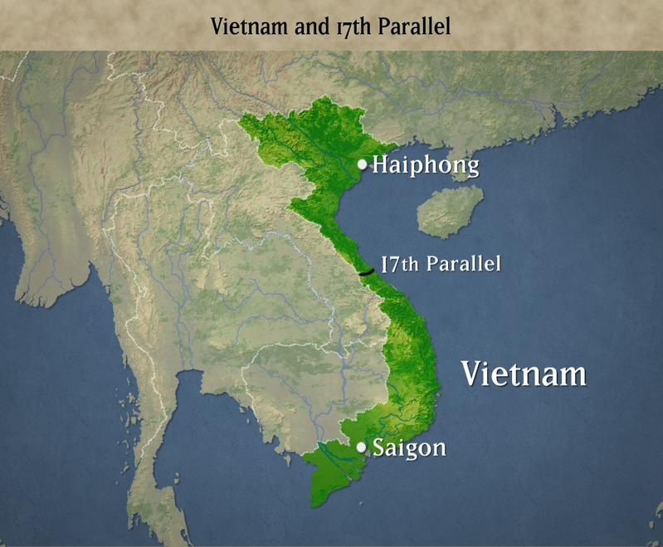

Slide 13
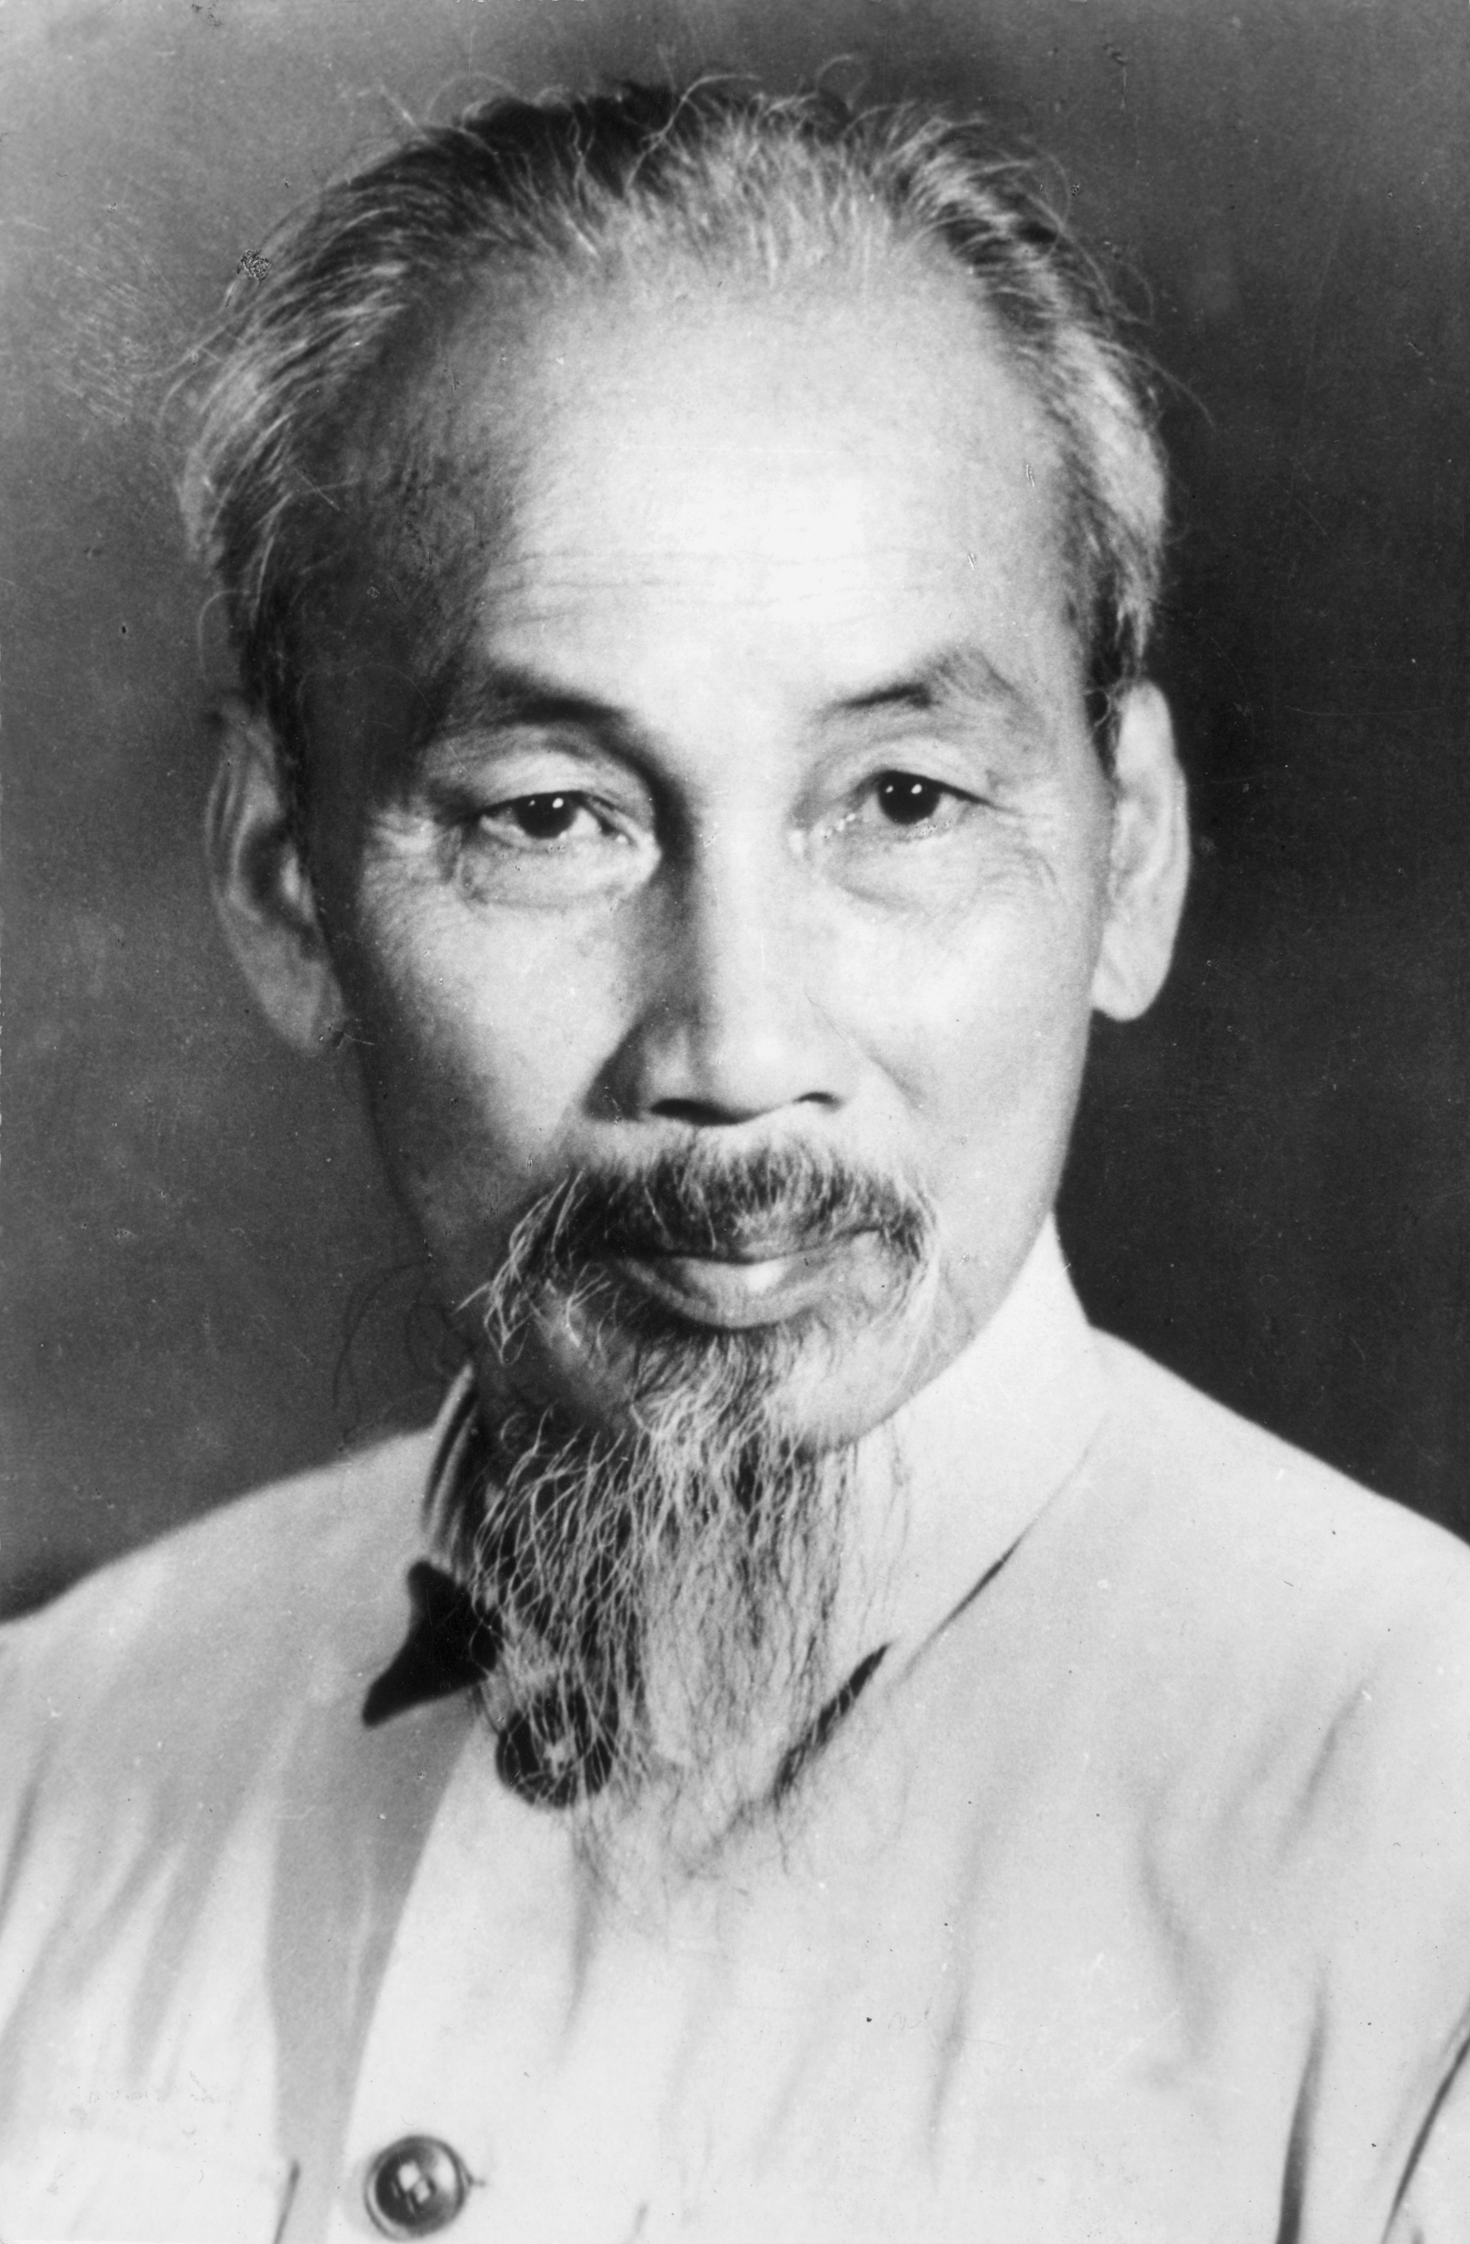
Conflict Between North and South Vietnam
North Vietnam’s leader was Ho Chi Minh
Totalitarian and repressive
He gave land to peasants, which made him popular
Wanted to unify North and South Vietnam under a Communist government

Slide 14
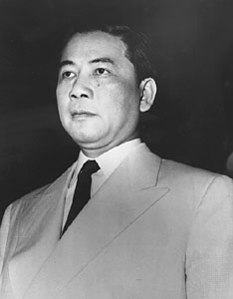
Conflict Between North and South Vietnam
South Vietnam’s leader was Ngo Dinh Diem
Government was corrupt, brutal, and unpopular
Late 1950s - a civil war broke out in South Vietnam

Slide 15
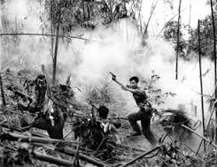
Growing Conflict in Vietnam
Diem’s opponents in South Vietnam began to revolt
Vietcong – The National Liberation Front
North Vietnam supplied weapons and troops to Vietcong

Slide 16
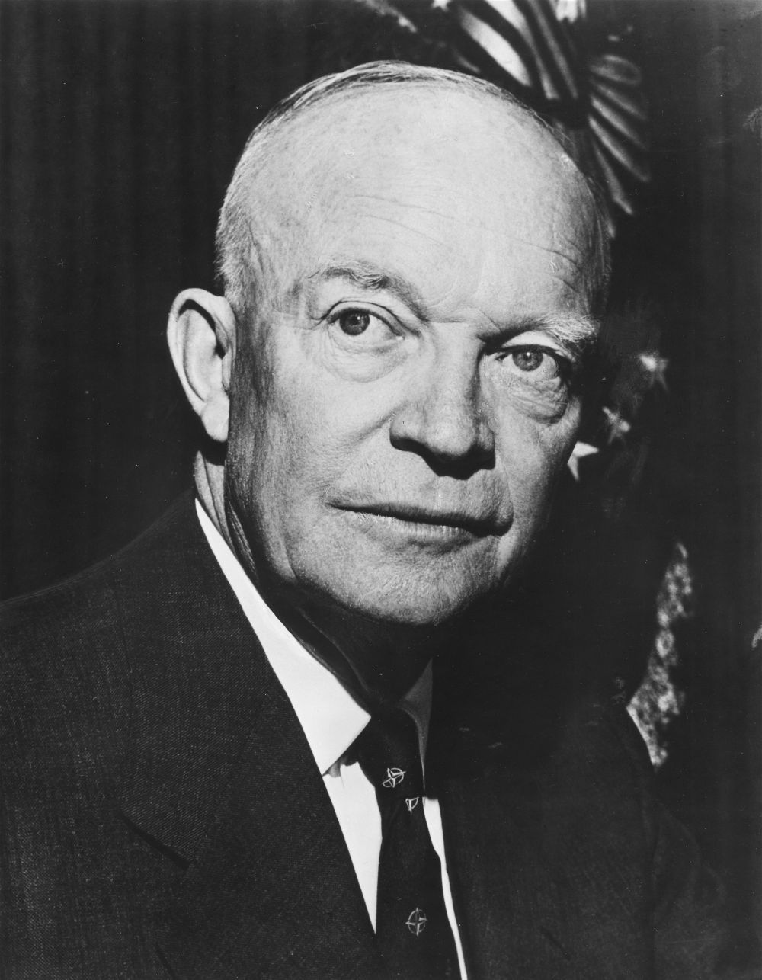
U.S. Involvement in Vietnam
Eisenhower
Began sending money, weapons, and advisors to South Vietnam

Slide 17
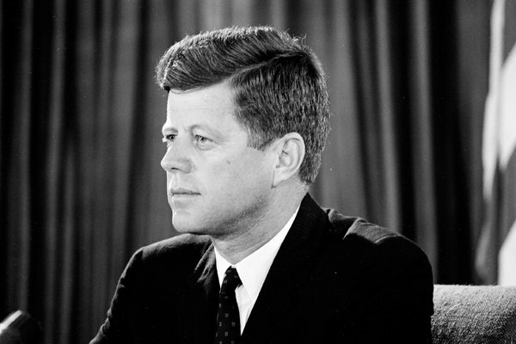
U.S. Involvement in Vietnam
Kennedy
Believed in the Domino Theory
Increased the number of military advisors and army special forces
Advisors were not to take part in combat, but many did

Slide 18
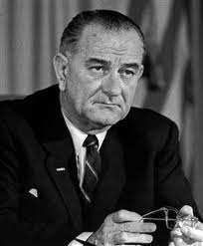
U.S. Involvement in Vietnam
Johnson
Believed an expanded U.S. effort was the only way to prevent a Communist victory in Vietnam

Slide 19
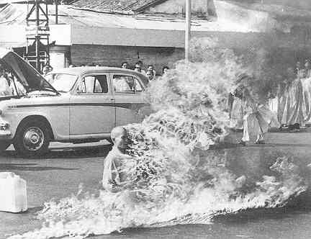
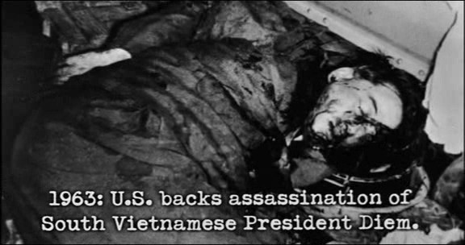
Increasing U.S. Involvement
Diem’s government continued to grow more and more unpopular
Arrested and killed protesters
U.S. withdrew support
South Vietnamese plotters murder Diem

Slide 20
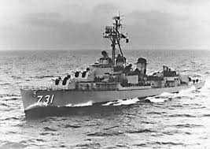
Increasing U.S. Involvement
The Tokin Gulf Incident
USS Maddox attacked by the North Vietnamese in the Gulf on Tonkin
On a spy mission
Fired first

Slide 21
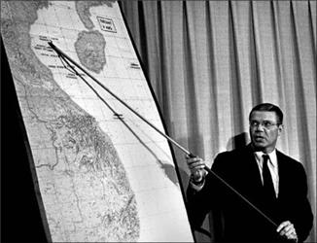
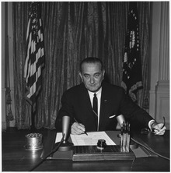
Increasing U.S. Involvement
The Tokin Gulf Resolution
LBJ claims attack was unprovoked
Got authority from Congress to increase military effort in Vietnam *

Slide 22
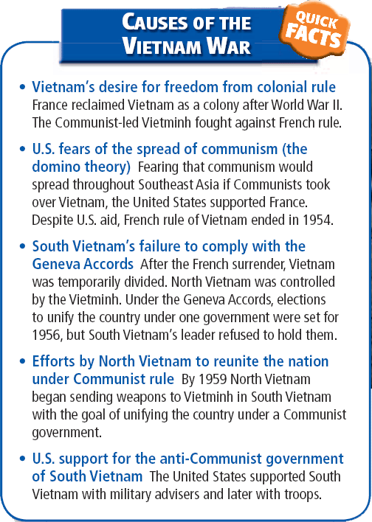

Slide 23
Chapter Questions
PAGE 955
2A
4A

Slide 24
The Vietnam War: U.S. Support of the War at Home and Abroad

Slide 25
Main Idea
As the United States sent increasing numbers of troops to defend South Vietnam, some Americans began to question the war.

Slide 26
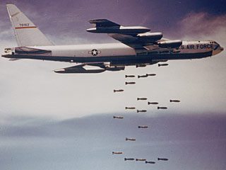
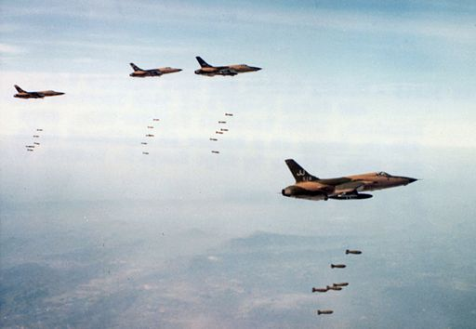
U.S. Failed to Quickly win the War
Operation Rolling Thunder
Bombing campaign over North Vietnam
the Ho Chi Minh Trail

Slide 27
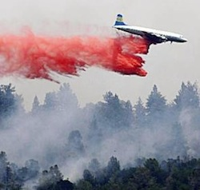
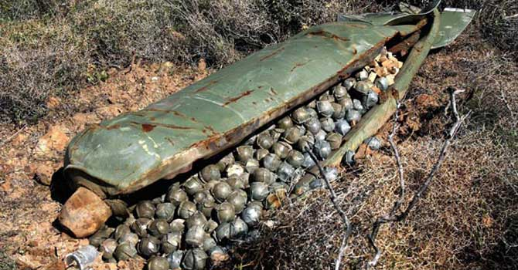
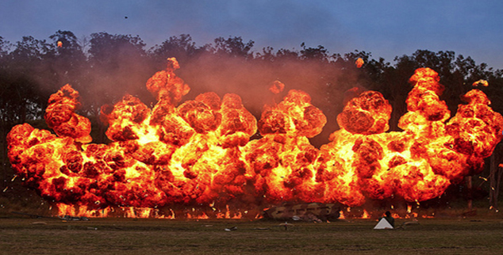
Weapons of the Air War
Agent Orange
Chemical designed to destroy vegetation
Napalm
“Cluster bombs”

Slide 28
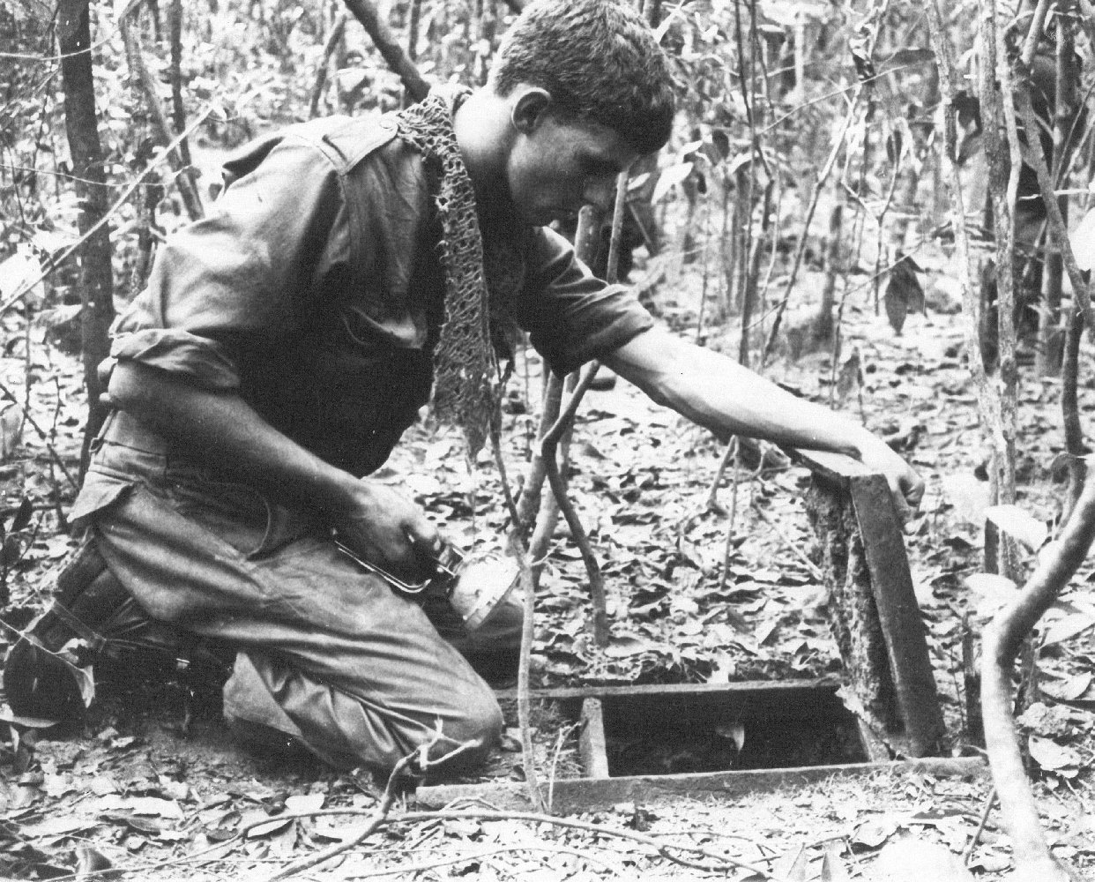
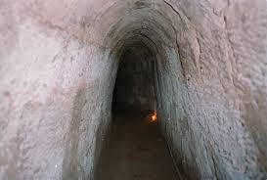
U.S. Failed to Quickly win the War
Bombing did not succeed
Flow of goods continued
Vietcong repaired damages
Had underground bunkers

Slide 29
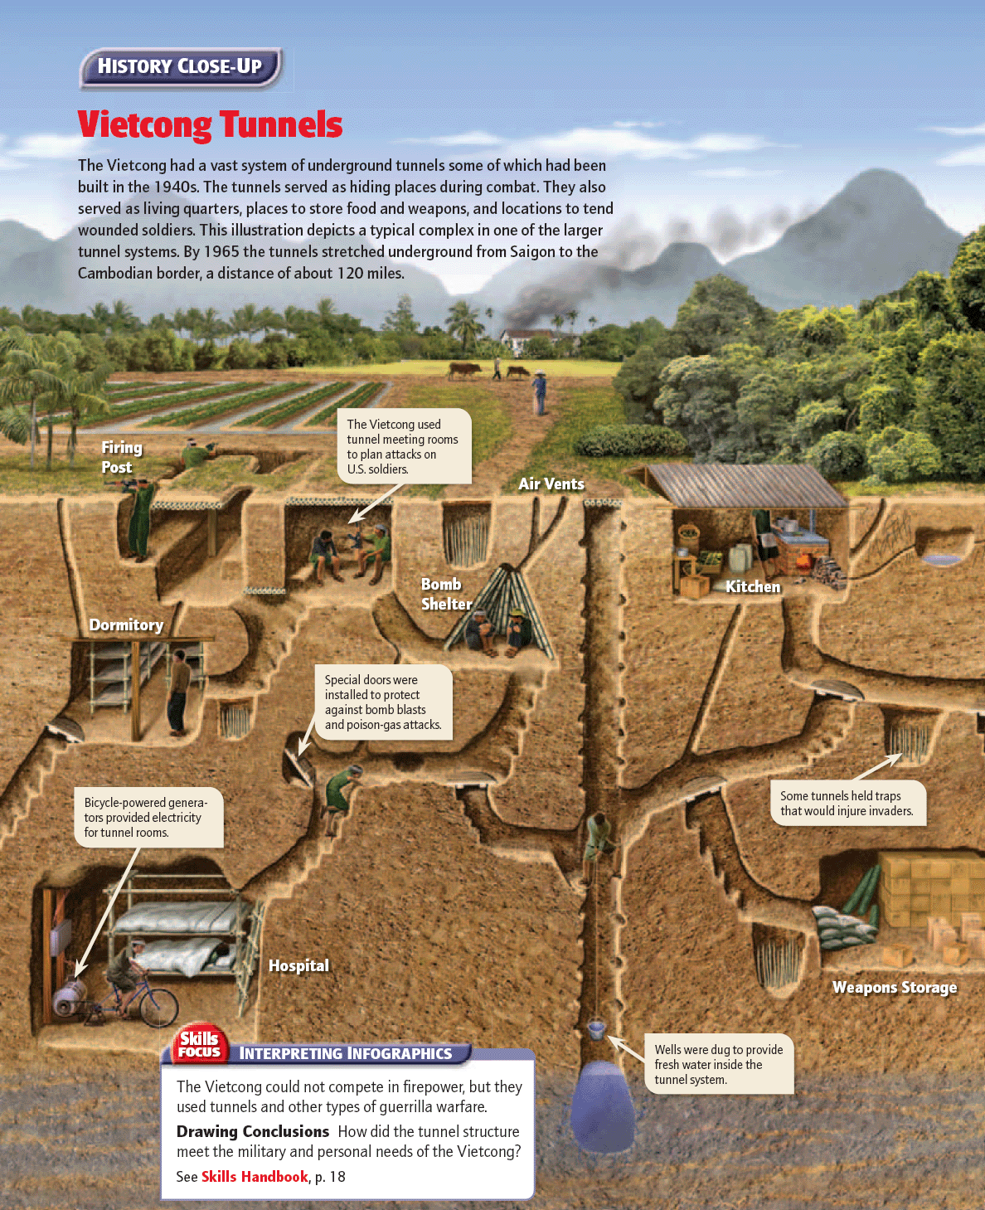

Slide 30
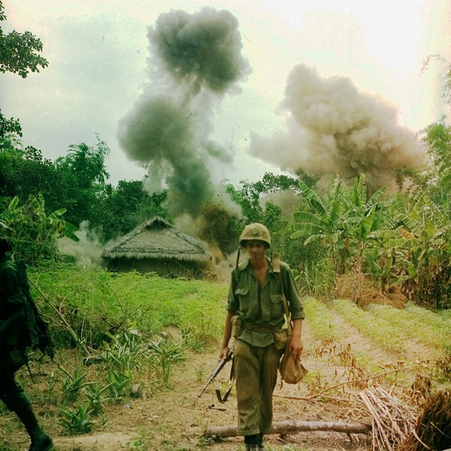
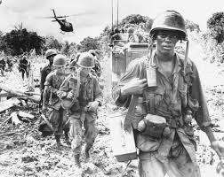
Difficult Ground War in Vietnam
U.S. ground forces in Vietnam continued to grow
Search-and-destroy missions
Ground troops located the enemy and called for air strikes
“Cleared” areas rarely remained that way

Slide 31
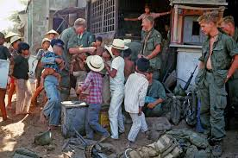
Difficult Ground War in Vietnam
Program of pacification *
Wanted to “win the hearts and minds” of the South Vietnamese people
Construction projects
Moved people out of villages when Vietcong nearby

Slide 32
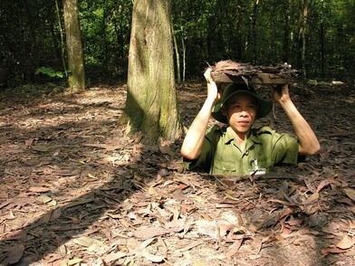
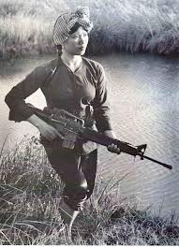
Declining Troop Morale
Vietcong used guerilla tactics
Knew the local geography
Nearly impossible to tell the difference between a Vietcong fighter and a civilian

Slide 33
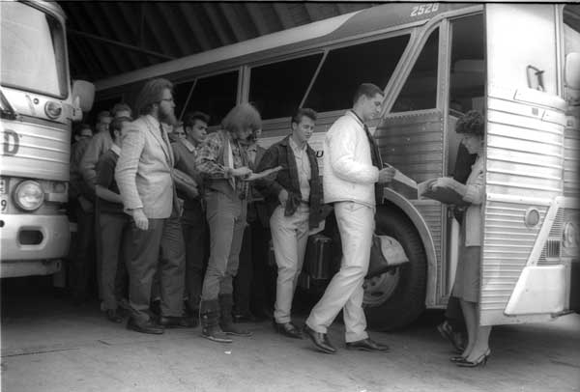
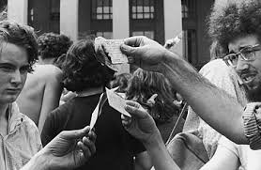
U.S. Forces Mobilize
More than 2.5 million Americans served in the Vietnam War
Volunteers and draftees *

Slide 34
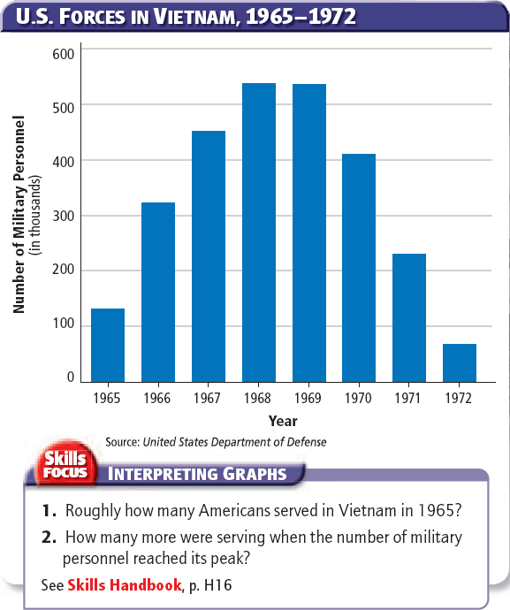

Slide 35
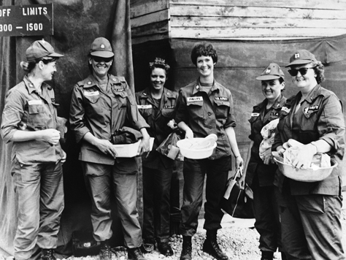
U.S. Forces Mobilize
Most Americans in Vietnam served in non-combat positions
About 10,000 American military women served

Slide 36
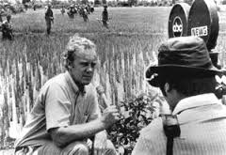
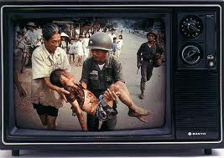
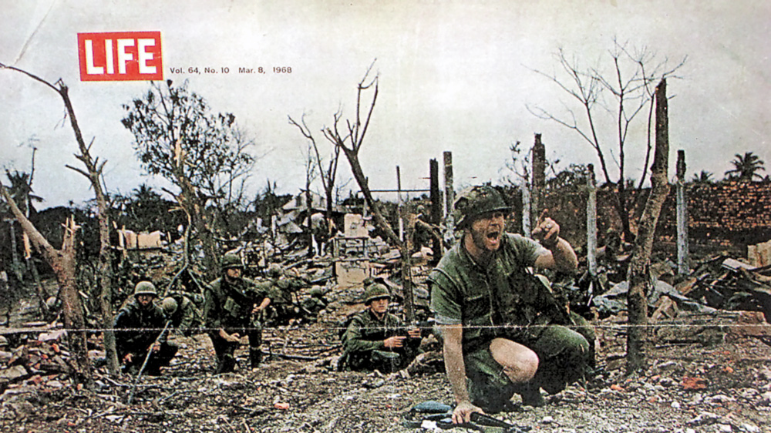
Public Opinion of the War
TV showed scenes of firefights and burning villages
Criticized the government’s reports about the war

Slide 37
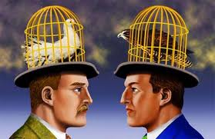
Public Opinion of the War
Doves
People opposed to the war
Hawks
People who supported the war’s goals
Both criticized the war effort

Slide 38
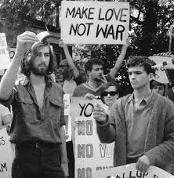
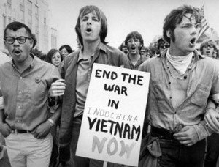
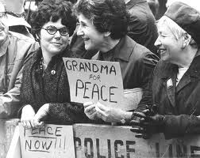
Public Opinion of the War
The Antiwar Movement
Attracted a broad range of participants
Mostly took place on college campuses *

Slide 39
The Vietnam War: 1968 – A Turning Point

Slide 40
Main Idea
As the Vietnam War dragged on and increasingly appeared to be unwinnable, deep divisions developed in American society

Slide 41
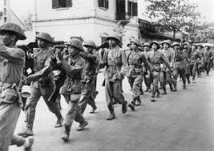
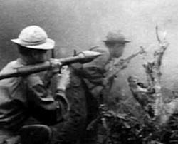
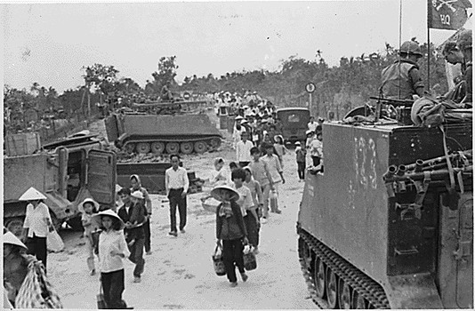
Tet Offensive
Tet Offensive
A series of massive coordinated attacks throughout South Vietnam

Slide 42
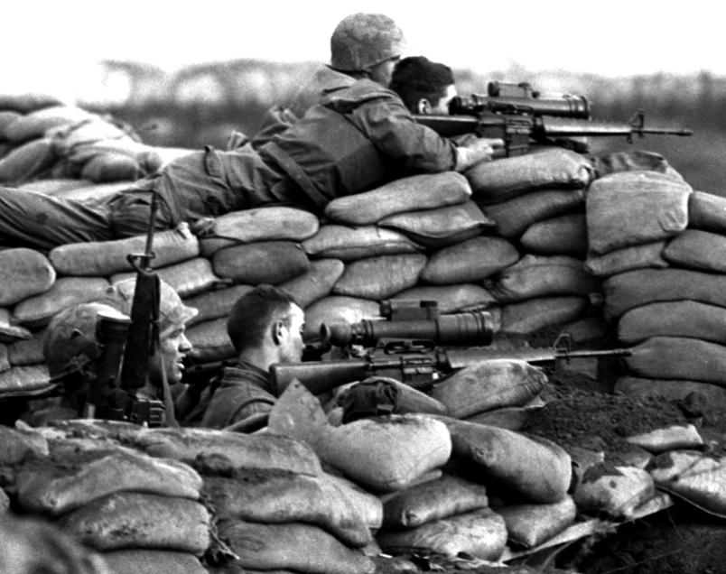
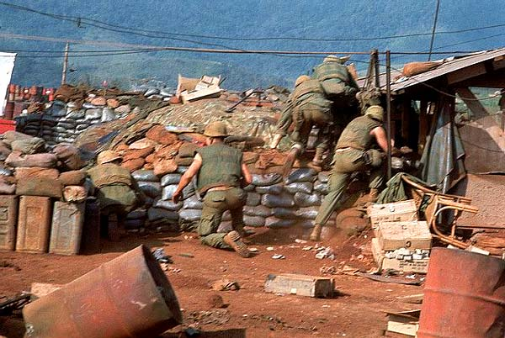
Tet Offensive
January 1968 – Vietcong troops attack a U.S. military base in Khe Sanh
This and other rural attacks were diversions
Wanted to draw troops away from urban areas

Slide 43
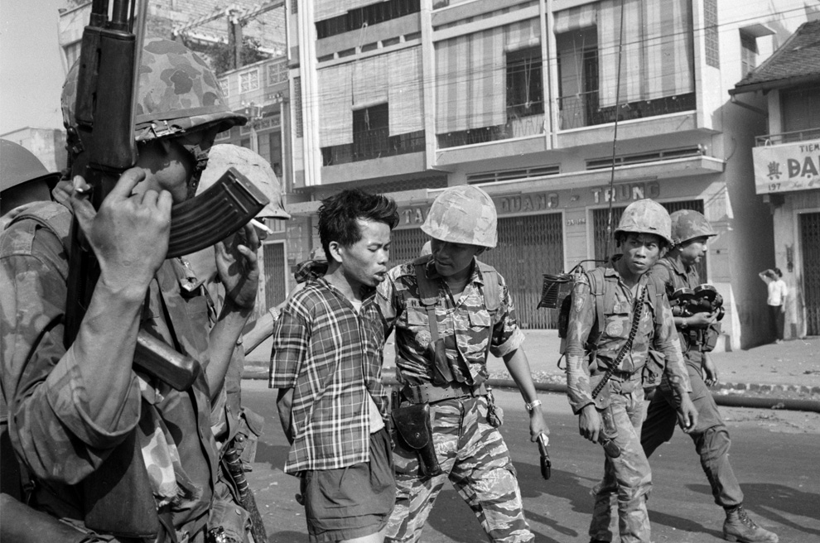
Tet Offensive
Began on January 30th, 1968: start of the Vietnamese New Year.
Cease-fire
Over 84,000 Communist soldiers attacked 12 U.S. military bases and more than 100 cities across South Vietnam

Slide 44
Effects of Tet Offensive
Tet Offensive a decisive defeat for the Communists
Showed that no part of South Vietnam was safe
Caused many Americans to question whether or not the war in Vietnam could be won
Walter Cronkite

Slide 46
Effects of Tet Offensive
Growing Doubts
Major news networks and magazines begin to express doubt about the war
Call for its end: “Hey, hey, LBJ, how many kids did you kill today?”
Public criticism of the government grew louder and more intense

Slide 47
Effects of Tet Offensive
Growing Doubts (continued)
Leaders within Johnson’s administration began to criticize Johnson’s policies
Johnson announces he will not run again
Robert S. McNamara began to seek ways to end the war

Slide 48
Searching for Solutions
McNamara suggested limiting air strikes and reversing the escalation of the war
LBJ decided to negotiate with the North Vietnamese

Slide 49
Searching for Solutions
The Paris peace talks
Stalled over two issues:
1.) The U.S. wanted all NVA troops out of South Vietnam
2.) North Vietnam would not accept a U.S. backed South Vietnam government

Slide 50
The Election of 1968
The Democratic Primary Fight
Vice President Hubert Humphrey
Senator Eugene McCarthy
Senator Robert Kennedy

Slide 51
The Democratic Convention
Debated between McCarthy and Humphrey
Outside the convention, protesters demanded an immediate end to the war
Troops sent to maintain order but violence soon broke out

Slide 52
The Democratic Convention
TV crews captured violent scenes between protesters and police
Illustrated a growing “generation gap”
Government, politics, and the Vietnam War

Slide 53
The Election of 1968
Richard Nixon (R), Hubert Humphrey (D), and George Wallace (I)
Nixon won 301 electoral votes
Promised “law and order”
Claimed to have a secret plan to end the war “with honor”

Slide 55
The Vietnam War: The War Ends

Slide 56
Main Idea
President Nixon eventually ended U.S. involvement in Vietnam, but the war had lasting effects on the United States and in Southeast Asia

Slide 57
Widening the War
Vietnamization
Strategy of turning over more of the fighting in Vietnam to the South Vietnamese while gradually bringing U.S. ground troops home
Hoped it would give South Vietnamese time to create a stable, non-Communist government

Slide 58
Widening the War
U.S. forces began to slowly withdraw
Antiwar activists wanted an immediate end to the war
Nixon believed he had the backing of the silent majority of Americans

Slide 59
Widening the War
Nixon was secretly expanding the war
He ordered the bombing of Cambodia and renewed bombing of North Vietnam
Sent troops into Cambodia and Laos

Slide 61
Increasing Protests
Kent State University in Ohio
4 students were killed and 9 injured
Jackson State College in Mississippi
2 students were killed and 9 wounded

Slide 62
Increasing Protests
Polls showed that 50% of Americans opposed the war
1969 - 250,000 protesters in Washington DC made up the largest antiwar demonstration in U.S. history

Slide 63
Increasing Protests
Some antiwar groups turned to violent measures
The Weathermen

Slide 64
Increasing Protests
The My Lai Massacre
U.S. troops killed at least 450 villagers while on a search-and-destroy mission
No Vietcong were found
Intensified divisions between war supporters and opponents

Slide 65
Increasing Protests
Pentagon Papers
Collection of secret government documents
Traced the history of U.S. military involvement in Vietnam
Revealed the government had been misleading the American people about the war for years

Slide 66
U.S. Involvement in Vietnam Ends
26th Amendment
Lowered the voting age from 21 to 18

Slide 67
U.S. Involvement in Vietnam Ends
Kissinger announced a breakthrough in the peace talks just weeks before the 1972 election
Helped Nixon win by a landslide

Slide 68
A Peace Agreement
U.S. agreed to withdraw all of its troops and help rebuild Vietnam
Both sides agreed to release all P.O.W.s
Did not settle the political future of South Vietnam

Slide 69
The Vietnam War’s Legacy
Two years after U.S. troops were withdrawn, North Vietnamese troops invaded South Vietnam
Vietnam was reunited under a Communist government

Slide 70
The Vietnam War’s Legacy
1975 - Communist forces called the Khmer Rouge gained control of Cambodia
1979 - Vietnam forces invaded Cambodia and overthrew the Khmer Rouge

Slide 71
The Legacy of the War – Southeast Asia
Over a million Vietnamese killed
Severe environmental damage from bombs and defoliants
More than 1.5 million South Vietnamese fled the country

Slide 72
The Legacy of the War - Veterans
Experienced a negative reception upon return
Trouble readjusting to civilian life (PTSD)

Slide 73
The Legacy of the War – Political Impact
U.S. failed to prevent Communists from taking over South Vietnam
Spent more than $150 billion on the war
Changed how many Americans viewed government
Congress passed the War Powers Act in 1973
*
*
*

Slide 75
Chapter Questions
PAGE 979
1C
2A
4A

Slide 76
Click on the window to start video

