Slide 1
From War to Peace: Postwar Havoc

Slide 2
Main Idea
Although the end of World War I brought peace, it did not ease the minds of many Americans, who found much to fear in the postwar years.

Slide 3
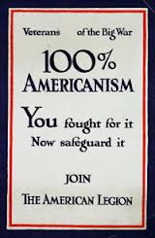
100 Percent Americanism
The end of WWI brought great rejoicing but also many problems:
Medical crisis
Farms and factories closed
Trouble finding work
Rise of the 100 Percent Americanism movement
Celebrated all things American while attacking ideas and people viewed as foreign or anti-American

Slide 4
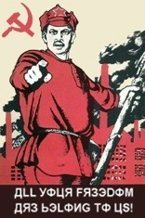
The Red Scare
Bolsheviks
Revolutionary group that gained control of Russia during WWI
Communism
Social system without economic classes or private property
Russia became the Soviet Union
Called for the overthrow of capitalism

Slide 5
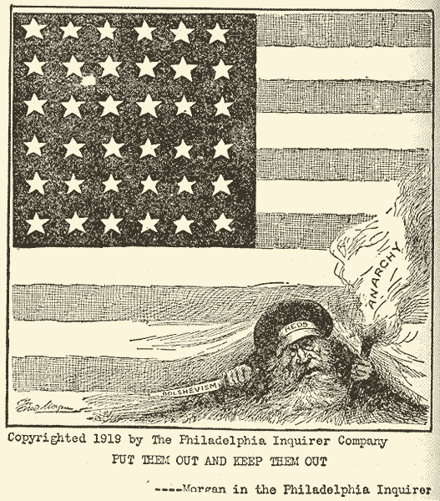
The Red Scare
Many Americans were frightened by communism
New target of hatred: Communists a.k.a. Reds
Red Scare
Widespread fear of communism

Slide 6
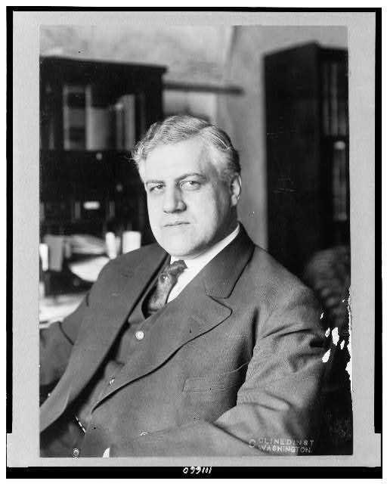
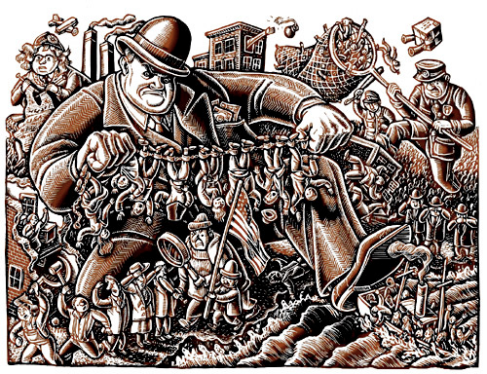
Plots, Laws, And Raids
A. Mitchell Palmer
Key leader in the government’s anti-Communist campaign
The Palmer raids
Attacks on suspected radicals
Used wartime laws that gave the government broad power against suspected radicals
Arrested thousands & deported hundreds of aliens

Slide 7
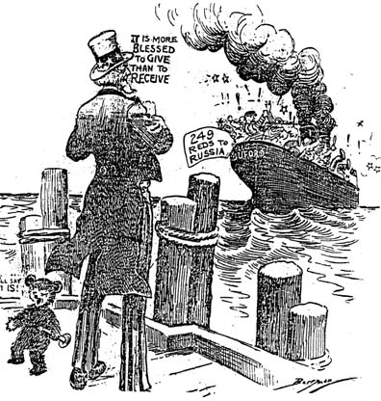
Plots, Laws, And Raids
Aliens
Citizens of other countries living in the U.S.
Deportation
Being sent back to one’s own country
Aliens just belonging to certain groups considered radical could lead to deportation

Slide 8
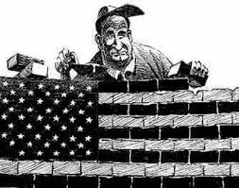
Problems for Laborers
Organized labor won many gains during WWI, but quickly became frustrated after the war
Sinking postwar demand
Lack of jobs
Returning soldiers
Unhappy workers and strikers were replaced
The Red Scare damaged labor’s reputation
Unions lost members and national political power

Slide 9
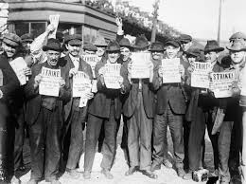
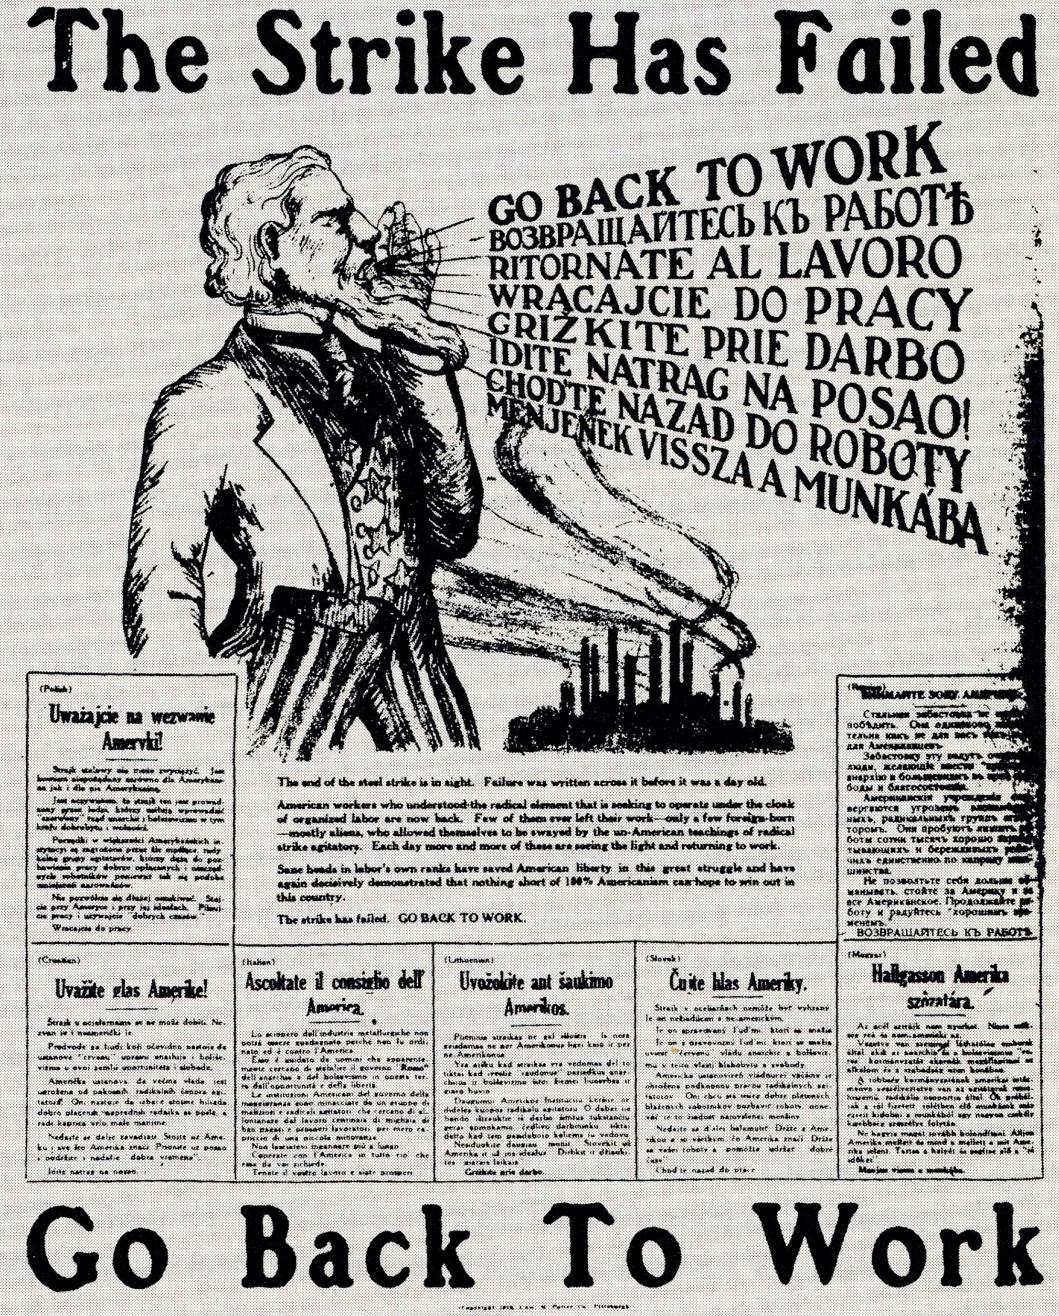
Major Strikes, But not major victories
1919 - Explosive time in the history of the American labor movement
Some 4 million workers took part in over 3,000 strikes nationwide
Labor lost in nearly every case

Slide 10
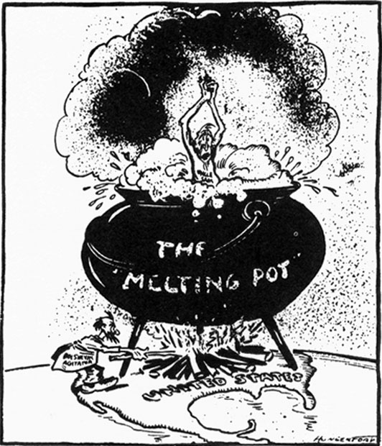
Limiting Immigration
The rise of nativism
Distrust of foreigners
Targeted newer arrivals from Southern and Eastern Europe
Catholics and Jews
Pushed for immigration restrictions

Slide 11
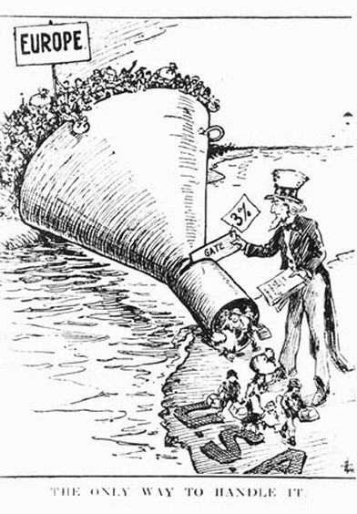
Reactions to Immigration
A 1921 law established a quota of immigrants to be allowed into the U.S.
The National Origins Act of 1924

Slide 12
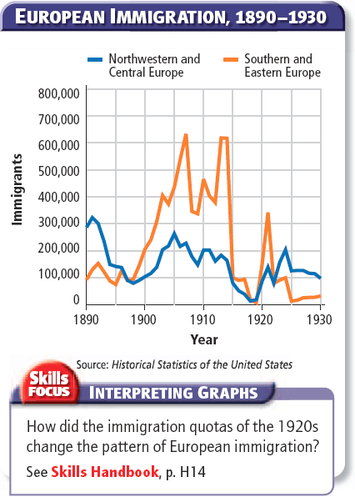

Slide 13
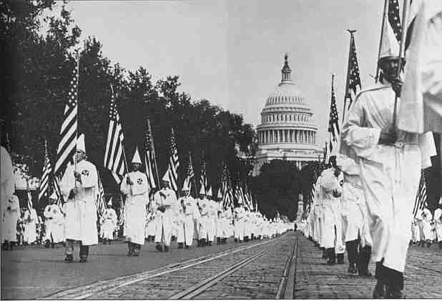
REACTIONS TO IMMIGRATION
Revival of the Ku Klux Klan (KKK)
Moved from the South into other parts of the country
Targeted African Americans, Jews, Catholics, radicals
“Native white, Protestant supremacy”

Slide 14
From war to peace: A new Economic Era

Slide 15
Main Idea
New products, new industries, and new ways of doing business expanded the economy in the 1920s, although not everyone shared in the prosperity.

Slide 16
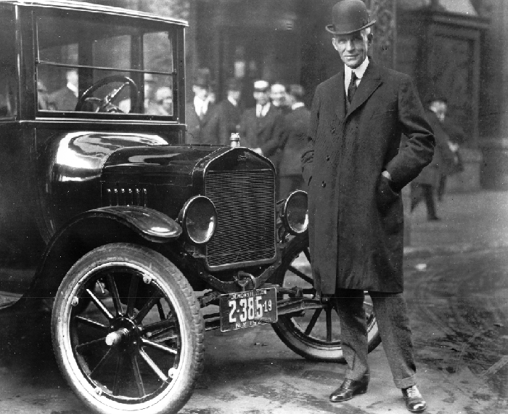
ford Revolutionizes Industry
The first cars appeared in the U.S. in the 1800s, but only the rich could buy them
Henry Ford
1908 - the Model T

Slide 17
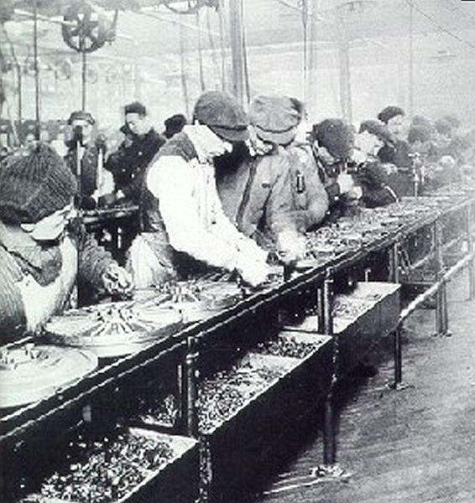
ford Revolutionizes Industry
Assembly line
Production system in which the item being built moves along a conveyor belt to workstations that usually require simple skills
Interchangeable parts
Make products identical and simple

Slide 18
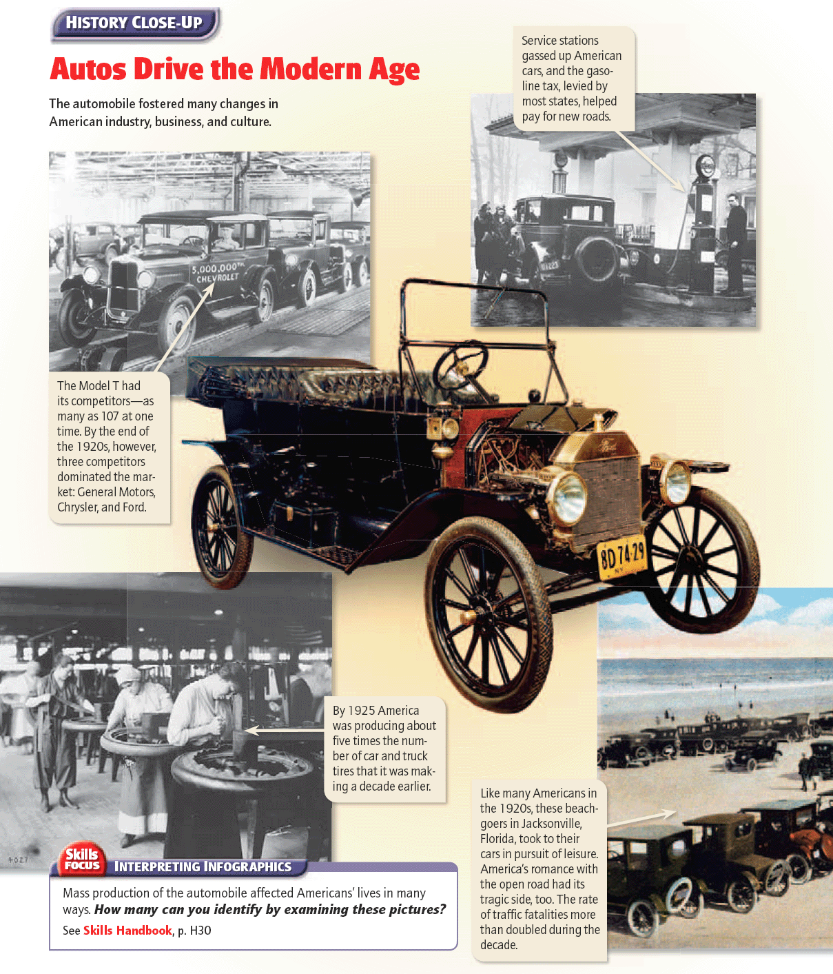

Slide 19
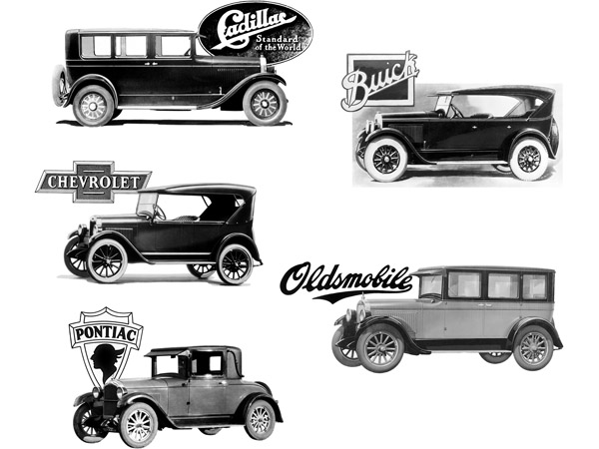
The Effects on industry
Other industries learned from Ford’s ideas
More competition
General Motors and Chrysler
Raised productivity
Measure of output per unit of input (like labor)

Slide 20
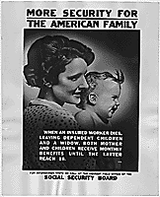
The Effects on industry
Welfare capitalism
System in which companies provide benefits to employees to promote worker satisfaction and loyalty (and accept lower pay)
Company-paid pensions
Recreation programs

Slide 21
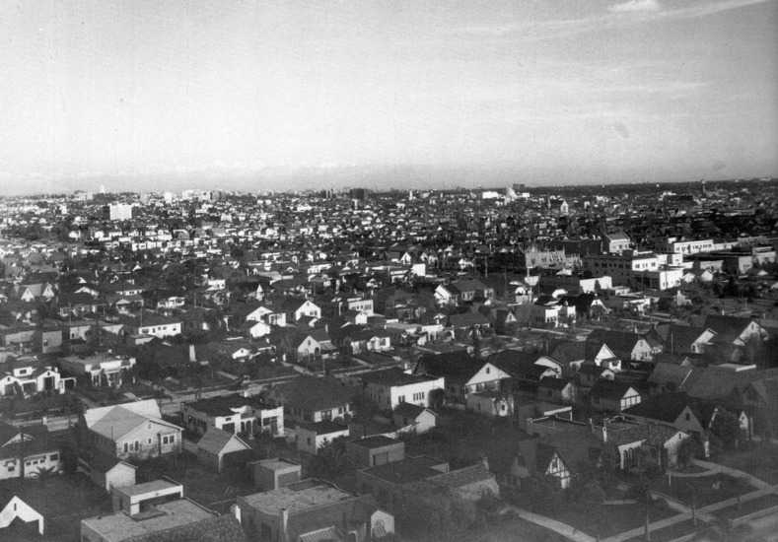
Industry Changes Society
Demand for steel, rubber, glass, and other car materials soared
Grow of cities
Growth of the suburbs
Freedom to travel by car produced a new tourism industry
Auto repair shops, filling stations, motels, restaurants

Slide 22
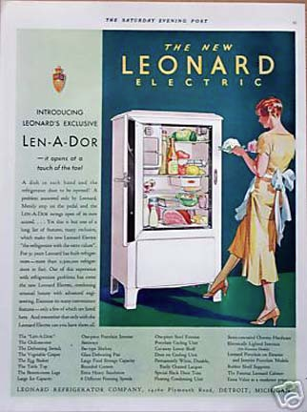
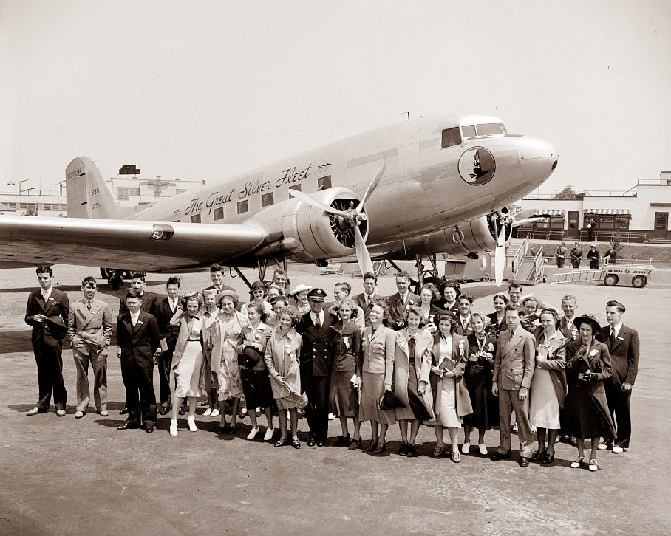
The new consumer
During the 1920s, an explosion of new products, experiences, and forms of communication stimulated the economy
Electrical appliances
Refrigerators, vacuum cleaners, radio
The first passenger airplanes

Slide 23
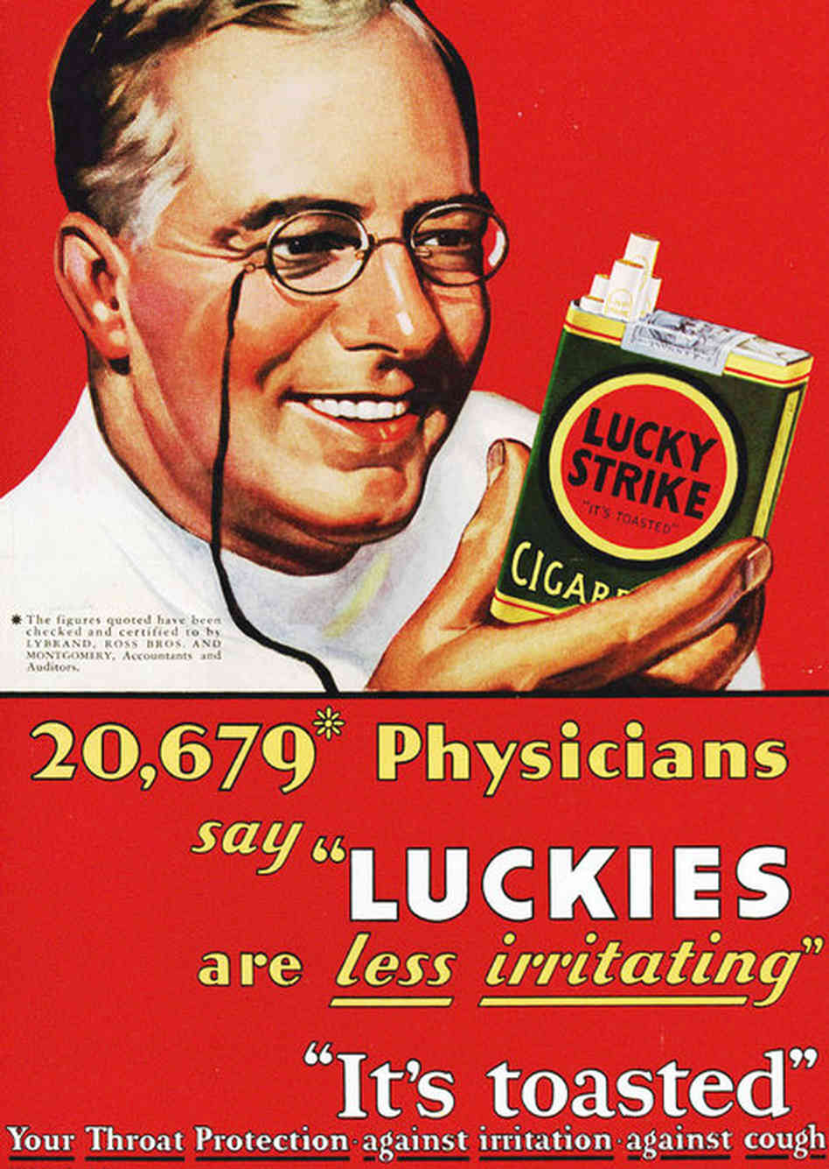
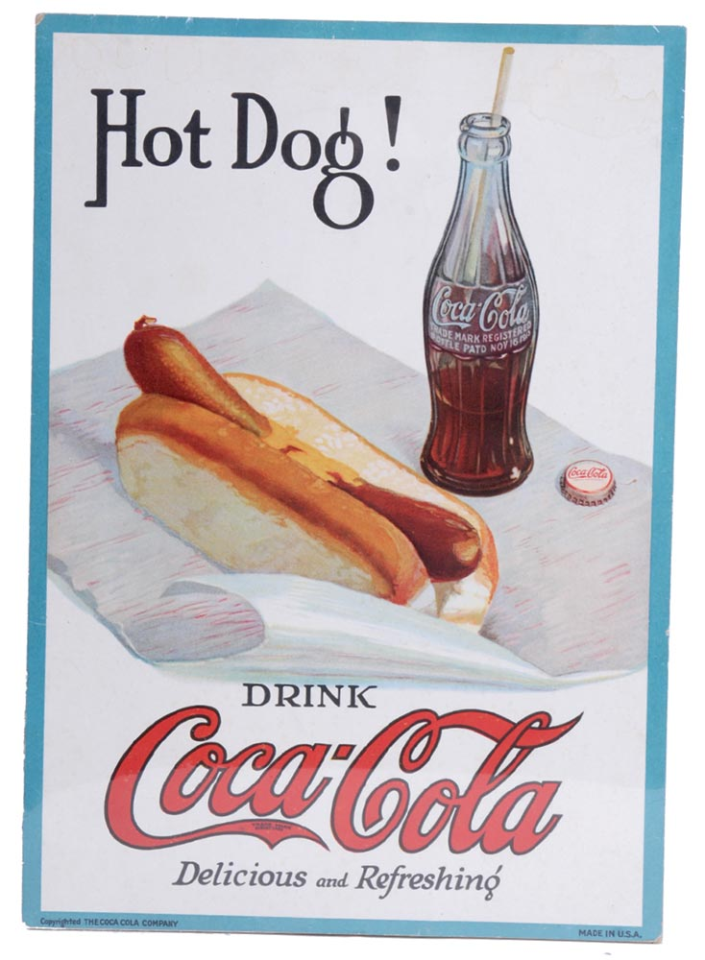
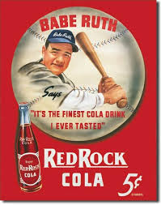
The new consumer
Persuasive advertising
Advertisers paid for space in publications and sponsored shows
Ads gave products wide exposure

Slide 24
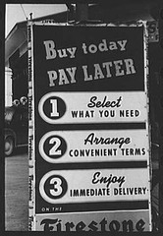
New ways to pay
Installment buying
Paying for an item over time in small payments
Credit
Borrowing money to make purchases
By the end of the decade, 90 percent of durable goods were bought on credit
Advertisers encouraged the use of credit

Slide 25
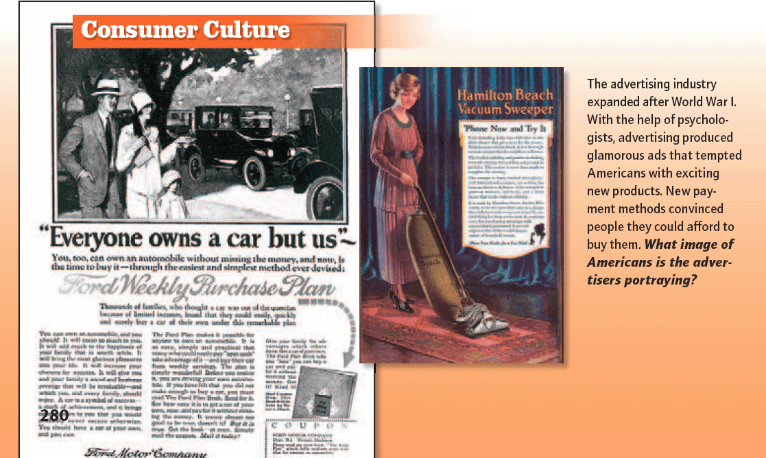

Slide 26
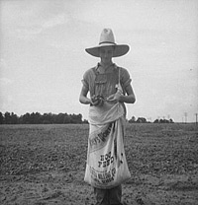
Weaknesses in the economy
Many Americans suffered in the postwar period
American farmers:
Demand for goods slowed
Competition from Europe reemerged
Natural Disasters
Land speculation boom came to a sudden end

Slide 27
From War to Peace: The Harding and Coolidge Presidencies

Slide 28
Main Idea
The nation’s desire for normalcy and its support for American business was reflecting in two successive presidents it chose – Warren G. Harding and Calvin Coolidge

Slide 29
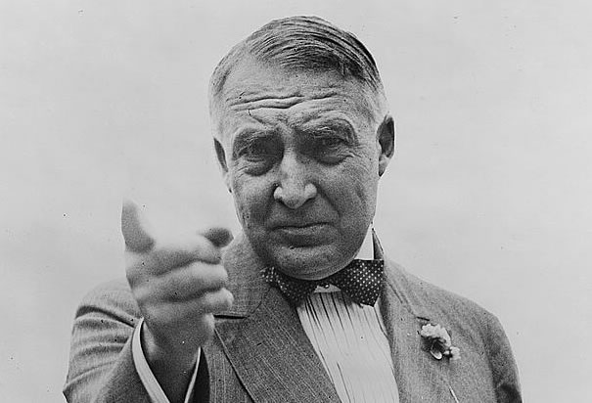
Warren G. Harding
As president, Harding regarded the job as largely ceremonial
Avoided taking hard stances on issues made him very popular
Message about a return to “normalcy” appealed to Americans

Slide 30
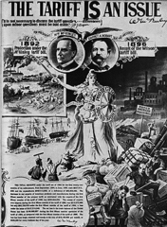
Harding’s presidency
Big business
Small government
Cut taxes & programs

Slide 31
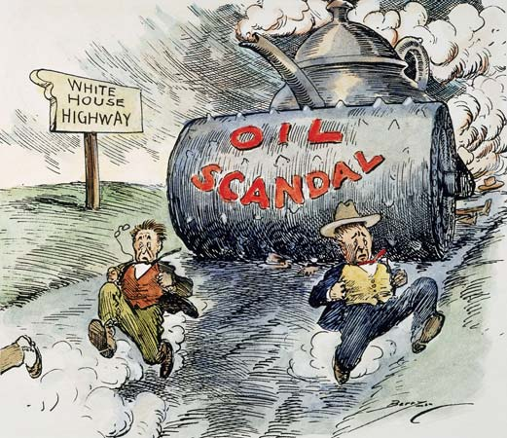
Harding’s Scandal & sudden death
Gave friends jobs in lower-level government posts
Some convicted of taking bribes
Teapot Dome
Secretary of the Interior Albert Fall was convicted and jailed for accepting bribes to allow oil companies to drill federal reserves on government land

Slide 32
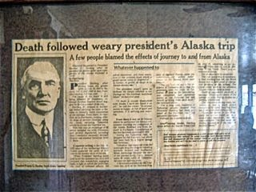
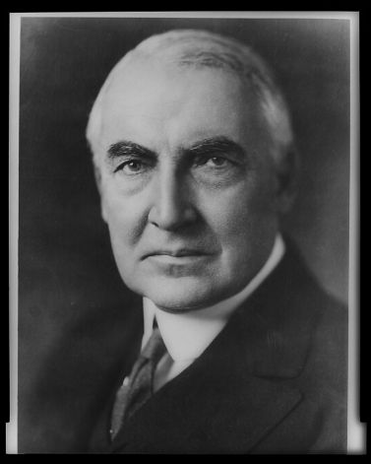
Harding’s Scandal & sudden death
Harding suffered from a heart attack
Popularity was high when he died
Own failings and the corruption of his administration soured his reputation over time

Slide 33
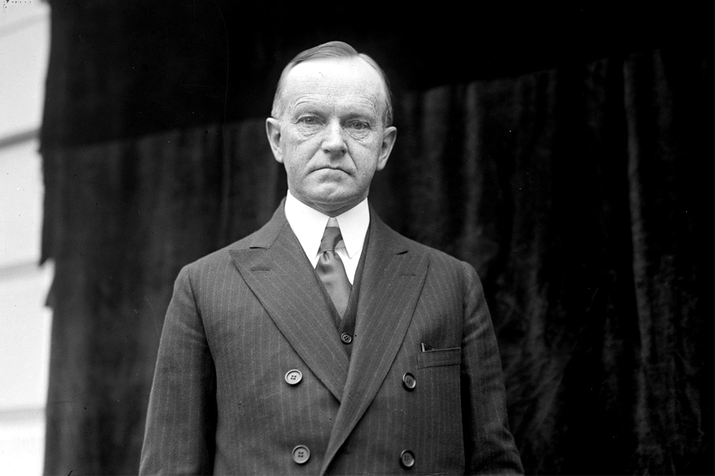
Calvin Coolidge
VP Calvin Coolidge took office after Harding’s death
Thought business helped society, and government should be limited
Lowered taxes, reduced federal spending, would not help farmers or war veterans

Slide 34
Lingering effects of WWI
During WWI, European nations had borrowed more than $10 billion from the U.S.
Allies unable to pay their debts
Germany was unable to pay (reparations) what the Allies demanded
U.S. lends money to Germany,
Assumes the role of banker to Europe

Slide 35
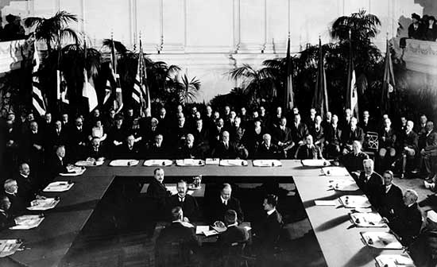
The Washington naval conference
Peacetime brought pressure to reduce the size of U.S. armed forces to save money and reduce war threats
People feared world naval power were in an arms race

Slide 36
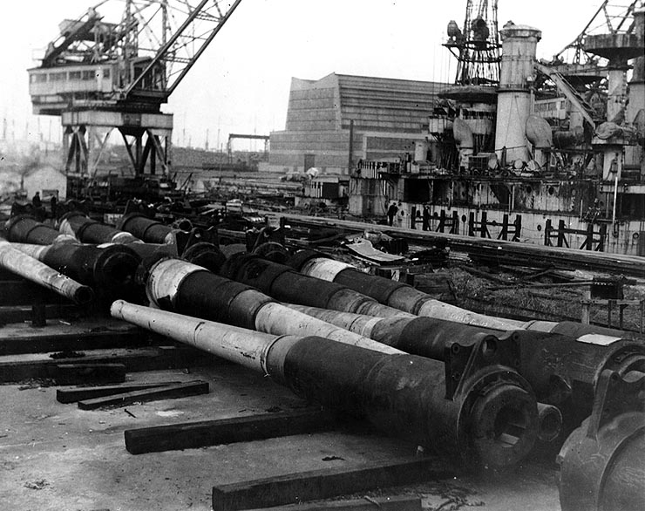
The Washington naval conference
The U.S. organized the Washington Naval Conference
Countries cut back the size of their navies and scrapped existing ships
Agreement on several issues threatening world peace
Many Americans thought the conference was a success

Slide 37
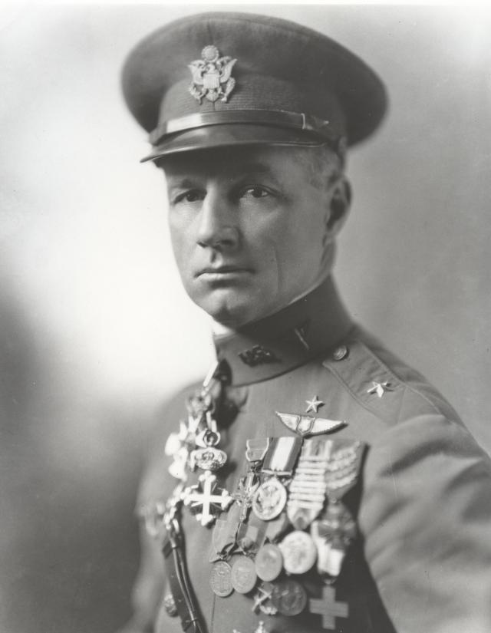
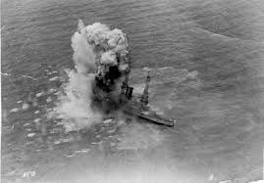
Billy Mitchell argues for air power
Brigadier General Billy Mitchell argued that the U.S. should invest more in building its air power
Commanded U.S. air combat operations in WWI
Other military officials weren’t convinced of the superiority of air power over naval power

Slide 38
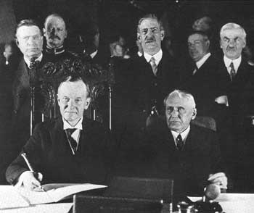
The Kellogg-Briand pact
Though the U.S. refused to join the League of Nations, a strong interest in preventing war remained
The Kellogg-Briand Pact
Stated that all countries who signed it renounced war as a solution for international controversies
Signed by 60 nations
Pact had no system for enforcement

Slide 41
Click on the window to start video

