Slide 1
World War II: Axis Aggression

Slide 2
Main Idea
In the late 1930s Germany and Japan used military force to build empires. Their aggressive actions led to the outbreak of World War II.

Slide 3
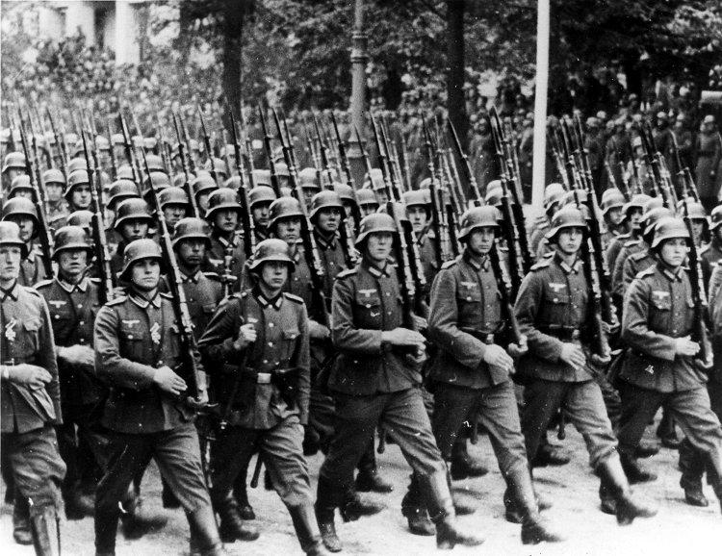
Germany Expands
Treaty of Versailles seriously damaged and humiliated Germany
Hitler came to power with promise to restore German greatness

Slide 4
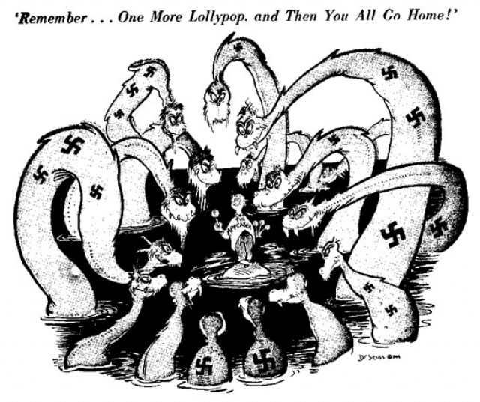
Germany Expands
Austria and Czechoslovakia are annexed
Become a part of Germany
Appeasement
Giving in to aggressive demands in order to maintain peace

Slide 5
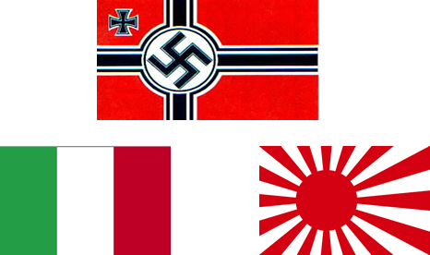
Alliances and Civil War
Similarities between Germany, Italy, and Japan
Totalitarian
Use military force to achieve goals
Disregard for the opinions of other nations
Later became known as the Axis Powers
Linked by the Anti-Comintern Pact & the Spanish Civil War

Slide 6
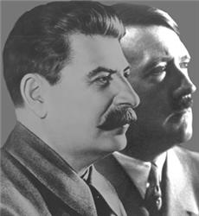
Alliances and Civil War
Stalin secretly negotiates deal with the Germans
Nazi-Soviet Nonaggression Pact
Agreement in which each side promises not to attack the other

Slide 7
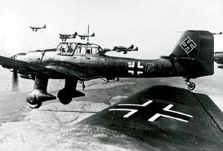
The War Begins
September 1, 1939 – Germany attacks Poland
Blitzkrieg “lighting war”
Emphasized speed and close coordination between planes and fast-moving forces on the ground

Slide 8
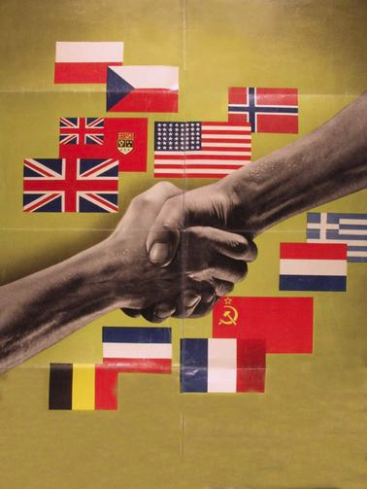
The War Begins
September 3 – Britain and France declare war on Germany
Become known as the Allies (Allied Powers)
Great Britain, France, eventually the Soviet Union and United States

Slide 9
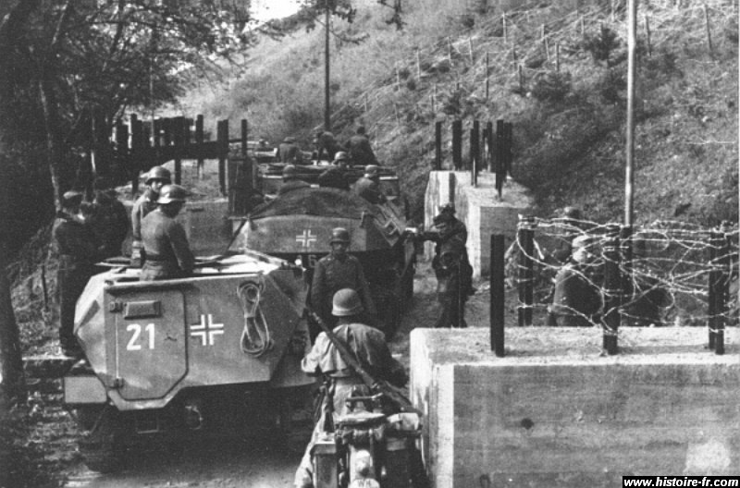
The Attack on France
Germany quickly takes Demark and Norway
Invades Netherlands, Belgium, and Ardennes
Have a clear path into France

Slide 10
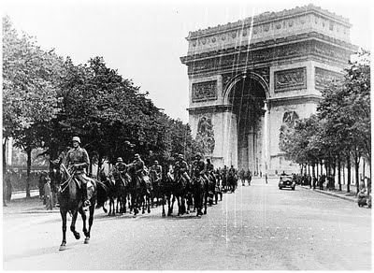
The Attack on France
June 22, 1940 – France surrenders to Germany
Vichy
French officials who cooperated with Hitler
Help run the country with Germany

Slide 11
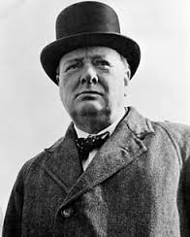
The Battle for Britain
Winston Churchill
Prime minister of England
“We shall fight on the beaches, we shall fight on the landing grounds, we shall fight in the fields and in the streets, we shall fight in the hills. We shall never surrender.”

Slide 12
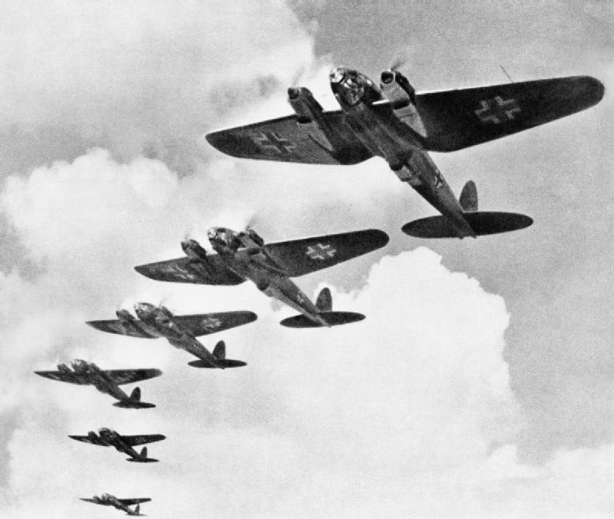
The Battle for Britain
Battle of Britain
Germany sends thousands of aircraft to attack British targets
Wanted to destroy the British Royal Air Force

Slide 13
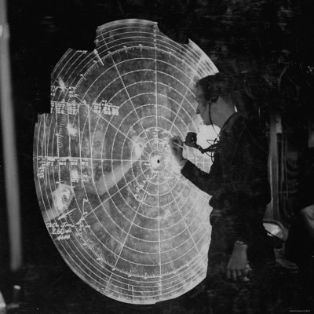
The Battle for Britain
British aided by new technology – Radar
Uses radio signals to locate and create an image of distant objects
Allowed British to detect incoming German air attacks

Slide 14
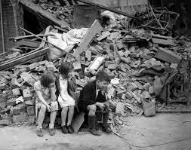
The Battle for Britain
London Blitz
Germans bomb British ports and cities
Bomb London 57 straight nights
As losses increased – Hitler calls of his plans to invade Britain
Germany’s first major loss of the war

Slide 15
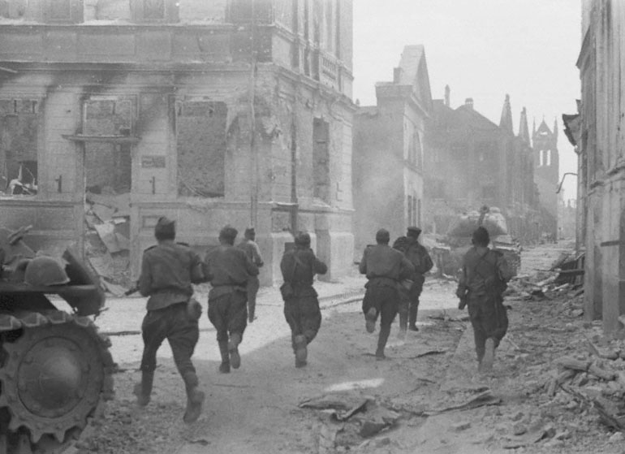
The Invasion of the Soviet Union
June 1941 – Hitler breaks the nonaggression pact
Sends 3 million German troops into the Soviet Union
Soviets had millions of soldiers, but were no match for Germans

Slide 16
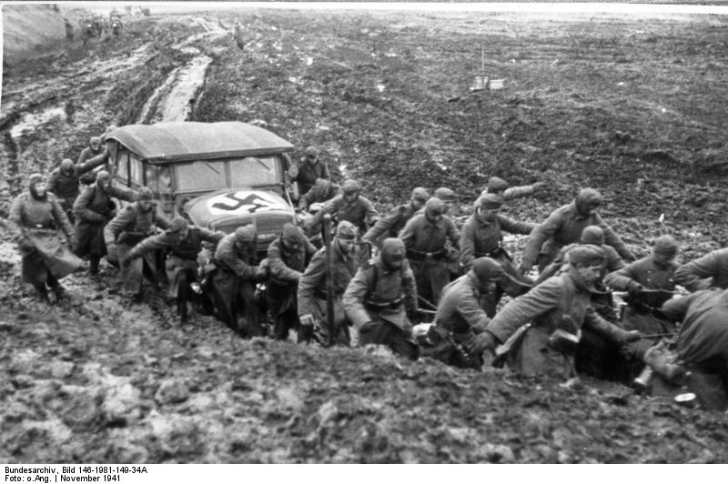
The Invasion of the Soviet Union
Germans weren't prepared for the harsh temperatures of the Soviet winter
Soviets beginning to recover & fight back

Slide 17
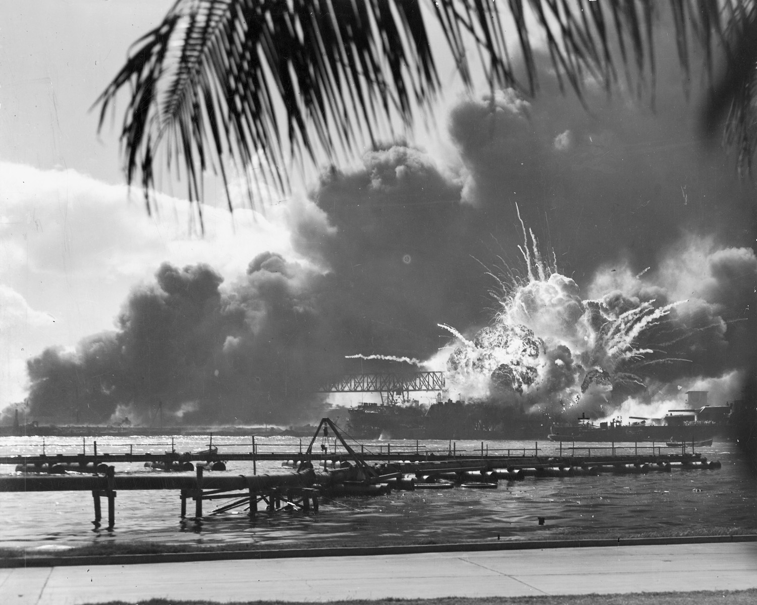
Japan Attacks
Planned a surprise attack on American naval base at Pearl Harbor, Hawaii
December 7, 1941 – Japan attacks

Slide 18
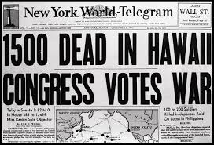
Japan Attacks
Prior to the attack many Americans believed in isolationism
December 9, 1941 – U.S. Congress declares war on Japan
U.S. joins to Allies **

Slide 19
World War II: The Allied Response

Slide 20
Main Idea
The early years of World War II went poorly for the Allies. But after the United States joined the war, the Allies soon recovered and began making gains against the Axis.

Slide 21
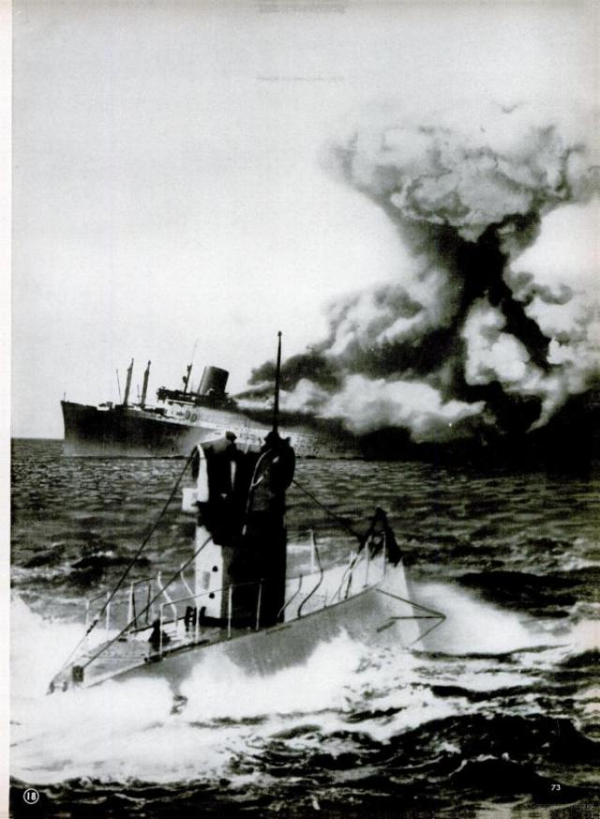
Early American Involvement
Control of the Atlantic Ocean critical factor for supplies
Before entering the war U.S. ships offered military aid to Great Britain
Escort ships
U-boats sink hundreds of American ships

Slide 22
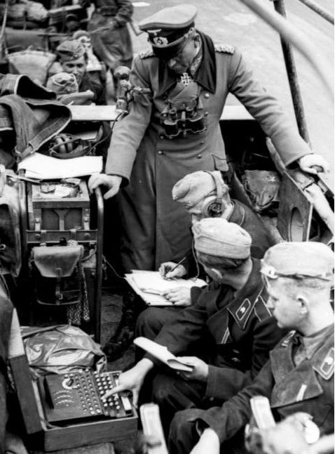
Early American Involvement
Factories begin producing ships in planes in large numbers
Helped break key German code system
Enigma
Losses to U-boats dropped

Slide 23
Early American Involvement
Millions volunteered to fight & millions drafted
Women took roles as pilots, clerks, nurses
Factories converted to produce weapons and supplies
New employment opportunities for women and minorities
Scrap drives and cutbacks on food, fuel, metals

Slide 24
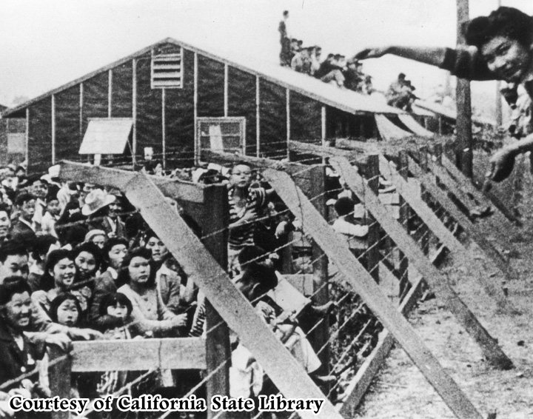
Early American Involvement
Worried that Americans of German, Italian, and Japanese decent would help the enemy
More than 100,000 Japanese on the west coast forced to leave their homes and businesses
Interment camps
Located in desert areas
Guards and barbed wire fences
Poor education and health care

Slide 25
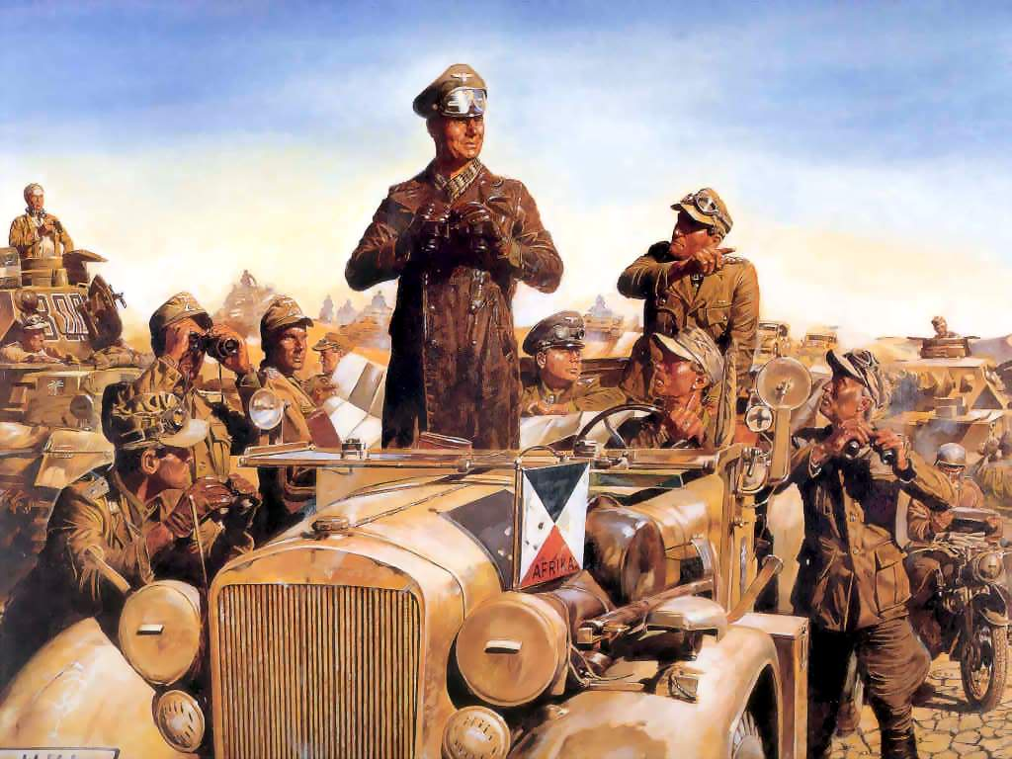
War in North Africa and Italy
Allies and Axis battling for control of North Africa
Need the Suez Canal
German forces join Italians and form the Afrika Korps
Erwin Rommel “the Desert Fox”
Pushes back the British

Slide 26
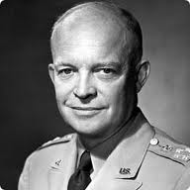
War in North Africa and Italy
Battle of El Alamein
Axis power in North Africa severely weakened
American forces led by general Dwight D. Eisenhower join the Allies in Africa
Germans and Italians now surrounded – forced to surrender

Slide 27
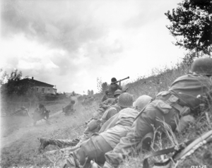
War in North Africa and Italy
Allied forces moved from Africa and landed in Sicily (Italy)
Force Benito Mussolini from power

Slide 28
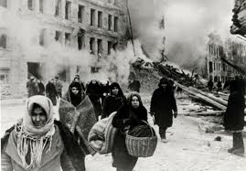
Turning Point in the Soviet Union
German invasion of Soviet Union slows down
Fails to capture Leningrad
Orders a siege of the city
Blockade designed to force city to surrender
Siege of Leningrad
Over 1 million civilians starve to death

Slide 29
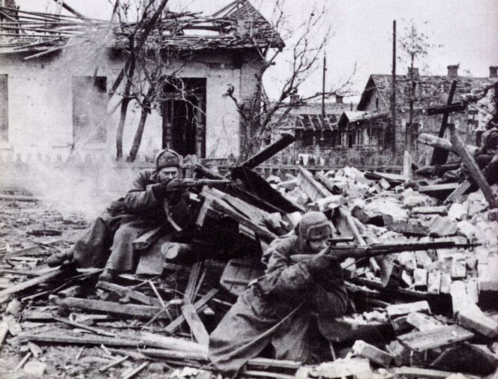
Turning Point in the Soviet Union
Hitler orders renewed assaults on the Soviet Union
Battle of Stalingrad
One of the largest cities in the Soviet Union
Its factories produced tanks, guns, military equipment
Germans bomb city into rubble
Stalin refuses to give up on city
Costs were high

Slide 30
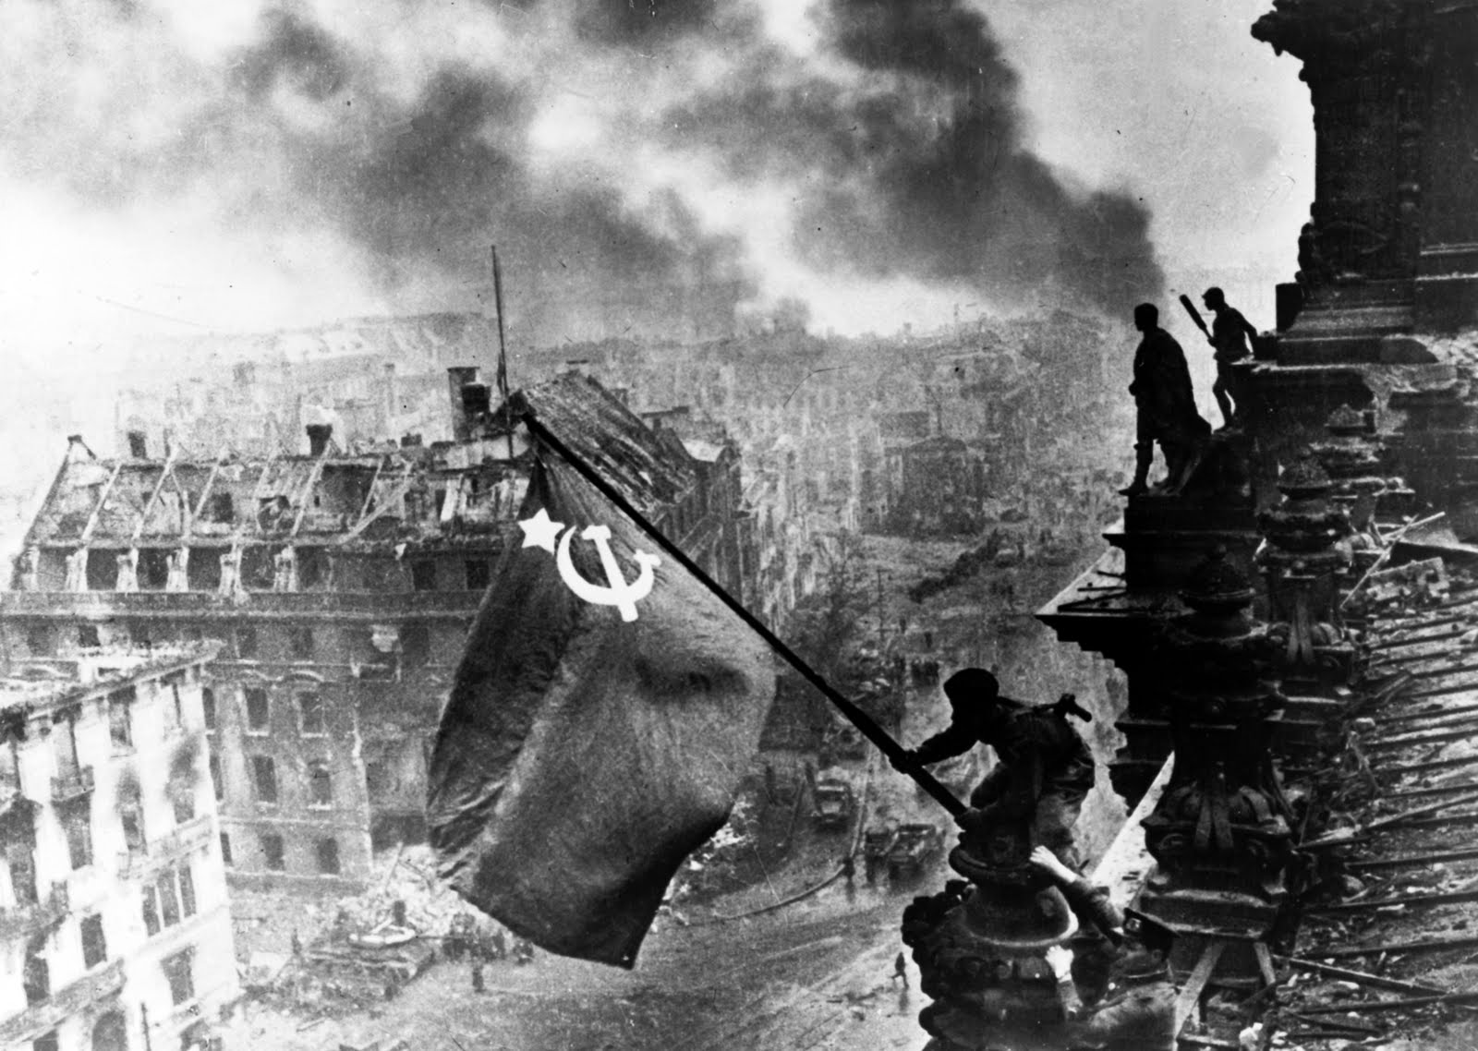
Turning Point in the Soviet Union
Soviet forces break through the Axis defenses
Hitler refuses to retreat
“Surrender is forbidden”
Hunger, cold, and Soviet attacks take a huge toll
Over 1 million Soviet soldiers killed
German army runs away or are captured and thrown into Soviet prison camps

Slide 31
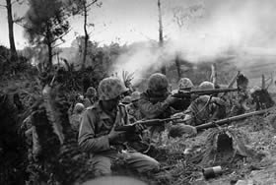
Turning Point in the Pacific
Early months in the Pacific difficult for the Allies
Majority of America’s Pacific fleet destroyed at Pearl Harbor
Japanese better equipped and fighting closer to home
Japanese take vital territory in Singapore, Hong Kong, Burma, and the Philippines

Slide 32
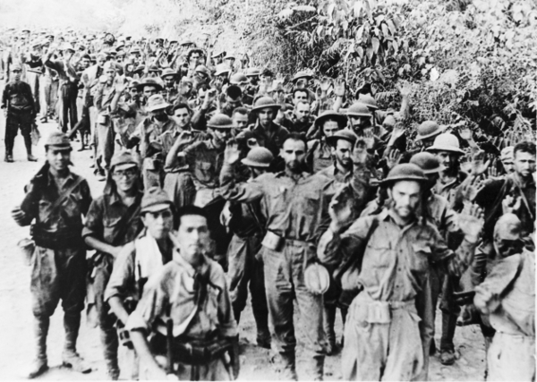
Turning Point in the Pacific
Bataan Death March
70,000 prisoners forced to march to a distant prison camp
Topical heat, lack of food and water, violence

Slide 33
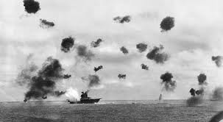
Turning Point in the Pacific
Battle of Midway
Japanese planned to capture island of Midway
Home to key American military base
Americans break the secret Japanese code to transmit messages
Knew the date and time of the Japanese attack
Japan’s navy takes a major blow
Allies could finally go on the offensive

Slide 34
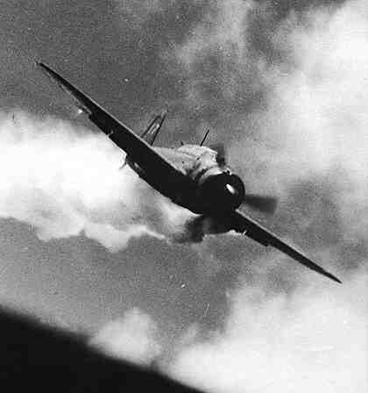
Turning Point in the Pacific
Island hopping
Would skip over Japanese strongholds and capture weaker targets
Captured islands used as bases for the next attack
Moved closer to Japan
Kamikazes
Japanese pilots who loaded their planes with explosives and deliberately crashed into Allied ships

Slide 36
World War II: The Holocaust

Slide 37
Main Idea
During World War II, Germany’s Nazi government deliberately murdered some 6 million Jews and 5 million others in Europe. These actions became known as the Holocaust.

Slide 38
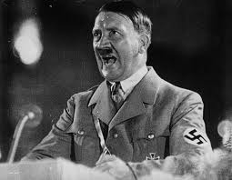
Nazi Anti-Semitism
At time of Hitler’s rise to power – approx. 9 million Jews in Europe
Germans blame Jews for Germany’s problems
Hatred based on race (not necc. Religion)
Nuremberg Laws

Slide 39
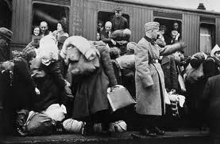
Nazi Anti-Semitism
Thousands of Jews deported or leave on their own
At the start of WWII – approx 250,000 Jews still living in Germany
Germany outlaws emigration – remaining Jews trapped

Slide 40
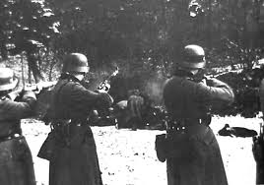
The “Final Solution”
Final Solution
Nazi plan for the deliberate mass execution of Jews
Used several brutal methods
Confined into ghettos
Mobile killing units

Slide 41
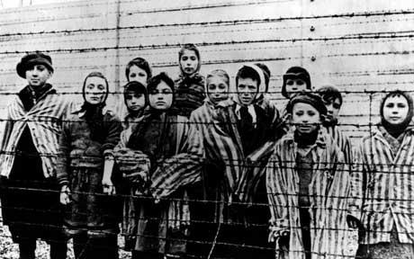
The “Final Solution”
Concentration camps
Labor camps built to hold enemies of the state
Jews, Poles, Slavs, homosexuals, people with disabilities, & Gypsies

Slide 42
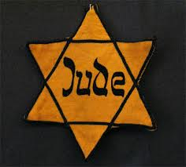
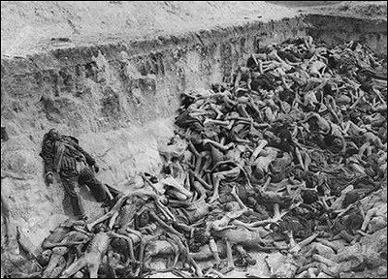
The “Final Solution”
The Holocaust
The killing of millions of Jews and others by the Nazis during WWII
Over 5 million died in concentration camps
Over 6 million Jews died at Nazi hands

Slide 43
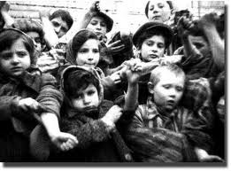
The World Reacts
People in United States and Europe begin hearing reports of widespread killing of Jews
War Refugee Board
Established to help rescue European Jews
Saved over 200,000 Jews
Unwilling to take actions like bombing railroads
Didn’t want to interfere with the war effort

Slide 44
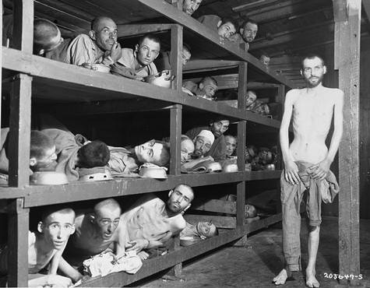
The World Reacts
As Allied forces advanced – started finding the Nazi death camps
Germans tried to cover up evidence by removing or killing the prisoners
Allies liberated those who remained **

Slide 45
World War II: The End of the War

Slide 46
Main Idea
In 1945 the Allies finally triumphed over the Axis Powers in Europe and the Pacific, but the war left many nations in ruins.

Slide 47
War Ends in Europe
Invasion of Europe would be difficult
Assault would have to be done by sea
Would have to be done against strong German positions
Needed a lot of soldiers and specialized equipment
Complex plan to mislead Hitler

Slide 48
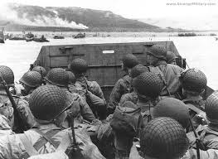
War Ends in Europe
D-Day
Allied forces invade France on the beaches of Normandy
High casualties
Huge victory for the Allies
Allowed for more Allied forces to pour in and break German defenses

Slide 49
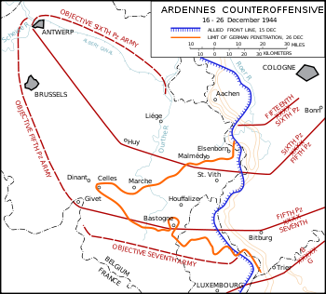
War Ends in Europe
Battle of the Bulge
Hitler orders one last massive counterattack in Belgium
Make advances, producing a bulge in the Allied battle lines
Eventually pushed back and crushed
Marked end of major German resistance

Slide 50
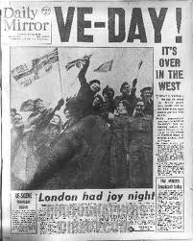
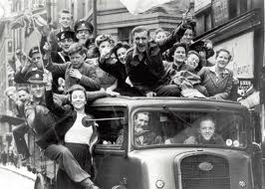
War Ends in Europe
Allies take the city of Berlin
Hitler’s body found in bunker
Took his own life
Germany surrenders on May 7 1945
V-E Day (Victory in Europe Day)
After 6 years, war finally over

Slide 51
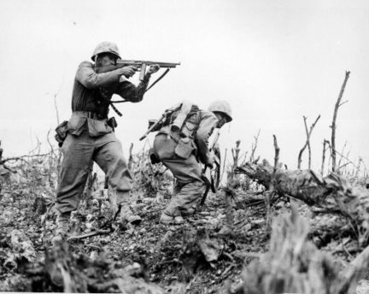
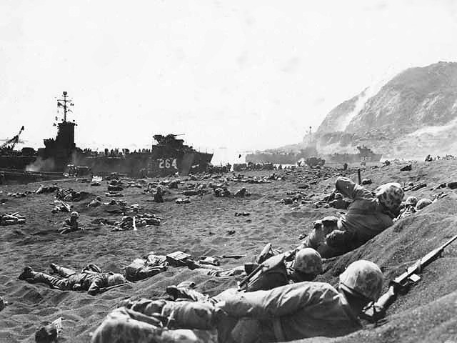
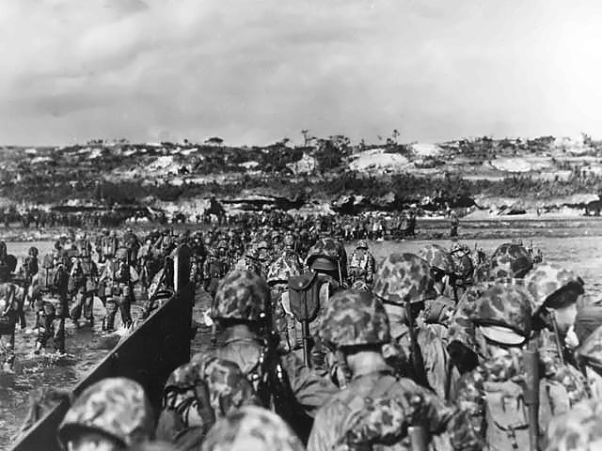
War Ends in The Pacific
Continued island-hopping strategy
Regular bombings on Japanese cities
Needed bases closer to Japan
Battle of Iwo Jima
Battle of Okinawa

Slide 52
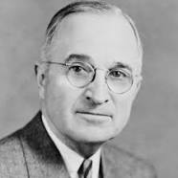
War Ends in The Pacific
Allies conclude that invading mainland Japan would be costly
Calculated that would cost up to 1 million soldiers
Harry S Truman
President after FDR died
Makes decision to drop the atomic bomb
Hoped it would cause Japan to surrender

Slide 53
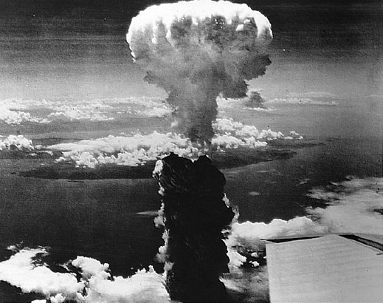
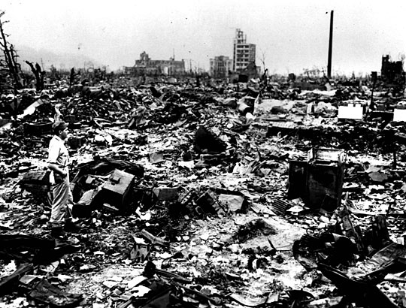
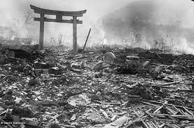
War Ends in The Pacific
Hiroshima & Nagasaki
Thousands die bombings and radiation poisoning

Slide 54
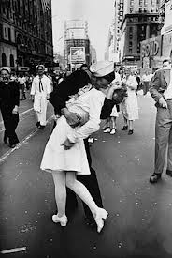
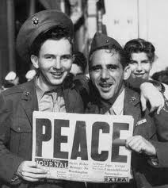
War Ends in The Pacific
V-J Day
August 15, 1945
Japan surrenders
WWII over

Slide 55
The Postwar World
Tens of millions died in war
Eastern Europe suffered heaviest losses
Entire cities, villages, and farms destroyed
Uprooted millions of people in Europe and Asia

Slide 56
The Postwar World
Yalta Conference
FDR, Churchill, and Stalin agree on plans for governing the soon-to-be-conquered Germany
Agree to form the United Nations

Slide 57
Causes of WWII
Economic hardship and political unrest following WWI
Aggressive leaders in Germany, Italy, and Japan wanted to expand their nations
Germany invaded Poland, and Japan attacked the United States

Slide 58
Effects of WWII
Millions of people were killed, and large areas of Europe and Asia were damaged or destroyed
The Allies occupied Japan and parts of Europe
The United Nations was created to help prevent future wars
Conflict began between the Soviet Union and the other Allies over the fate of Eastern Europe
The United States and the Soviet Union emerged as the world’s two major powers

